Slide 1
Python Training
Python Training:
Course Length: 4Days
Agenda:
Complete understanding of Python
We will provide resources (websites, assessments, doubt clarification)
Certification and Placement assistance
From Students side:
Participation and engaging
Understanding before questioning
Doubts clarification then and there
Exercise completion
Regular to classes
Sit and practice as much as you can
Classroom etiquette:
Turn cell phones off or to vibrate
Refrain from e-mail and web surfing

Slide 2
Course Structure
Python TOC.xlsx
Linear Data Structure (Lists, Strings, Tuples)
Hash data structures (dictionaries & Sets)
Control flow (if, elif, else, for and While)
Functions
GUI/ Tkinter
File Handling
Exception Handling
OOPS
Python and Database connection
ML & Dat Science(Linear Algebra, probability,
Statistics & Matrices)
Which of the following Python applications do you teach?
Web Development with Python
Automation with Python
Regular Expressions with Python
Web Scraping with Python
Data Analysis with Python
Data Extraction with Python
Data Science with Python
Data Visualization with Python
Text Processing with Python
Scipy Stack with Python
GUI with Python
Machine Learning with Python
Game Development with Python
Networking with Python
Testing with Python
Help in assignment
PySpark
Core Python

Slide 3
Prerequisite:
Before learning Python, you must have the basic knowledge of programming concepts.
Basic Mathematics
Logical Thinking
Problem solving skills
Ability to research and understand documentation
Time
Determination
Patience
Interest
Let us see the evolution of PCs:
https://www.youtube.com/watch?v=gjVX47dLlN8&t=28s
https://www.youtube.com/watch?v=NqgpZ_v4Ne8
https://www.youtube.com/watch?v=IKLVSxhkZeg

Slide 4
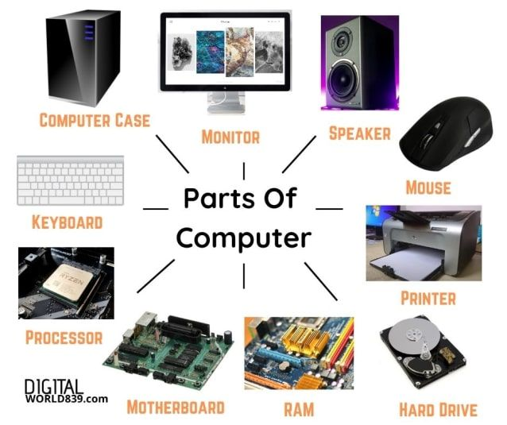

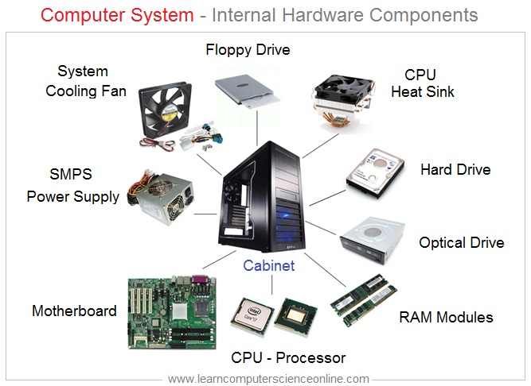

Slide 5
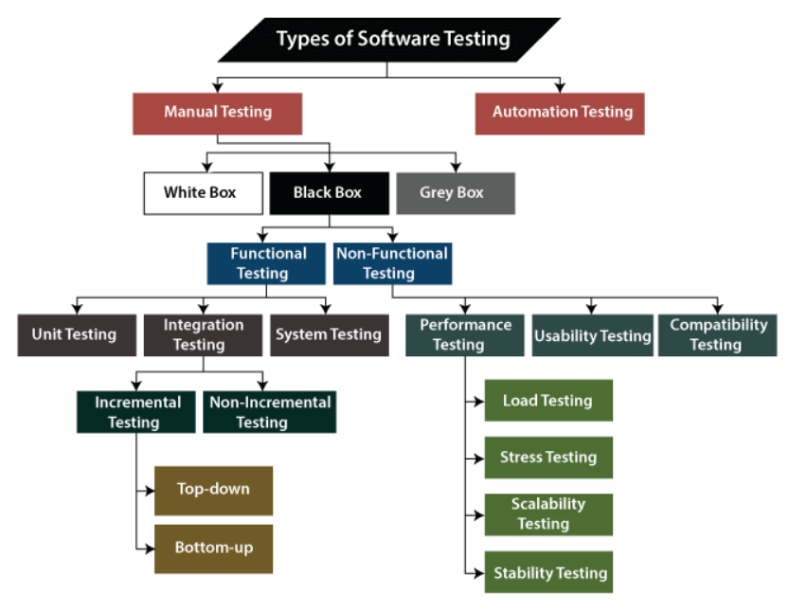
Life Cycle of Software Program
Planning & Analysis
Goals and objectives
Resources, Budget, Schedule
Identifying the stakeholders' needs and expectations
functional and non-functional requirements
Testing
Requirements and is free of defects.
https://www.geeksforgeeks.org/types-software-testing/
Program & Design
Programing & Designing & developing
source code
Necessary documentation.
(Web Developer, Android Developer, Game Developer)
(C,C++, Java, Python, HTML/CSS, PHP, Java Script, GO, Rust, Kotlin, Ruby)
Deployment & Maintenance
deployed and made available to users
maintained by fixing any bugs or errors that are found and updating the program to meet changing requirements.

Slide 6
Supporting Departments
Database Management
Data to be accessed, locked and modified
security, and backup and recovery
Cloud Computing
AWS
AZURE
GOOGLE
Networking Support
Transporting and exchanging data
https://www.nwkings.com/computer-network-components
Operating Systems
WINDOWS
LINUX
IOS
UI/UX
User-friendly interfaces….look and feel of an app or website's user interface is called user interface design.
user experience (UX) study how people use products, conduct usability tests.
https://coggle.it/diagram/ZtMDf8rvLIwlbc-0/t/backend-engineering/44ac2c05e0c7fcdd9920723c49ec128e5a65bcc430a145638eb01f5c64a884a1

Slide 7
Stake Holders in Software Program Life Cycle
Project Manager & Client
Stake Holders: SME, End User, BA, Owners
UI/UX (Design)
Front End, Back End & Full Stack Developers (Development)
Testers (Testing)
Devops (Deployment)
Production Support Engineer (After Deployment)
Data Base Engineer (Maintain Data)
Network Engineer (Protocols, Trouble shooting, Security)

Slide 8
Job opportunities after Python:
Data Science: Data science extends to numerous industries, and using Python to understand data is paramount. Python libraries like NumPy and Matplotlib enable Data Scientists and other professionals to use visualization to gain insights into data. Additional top Python libraries include TensorFlow, SciPy, Pandas, and Scikit-learn.
Artificial Intelligence (AI) & Machine Learning (ML): Machine Learning Engineers and Architects use Python to build models. At the same time, AI Engineers and Architects may need this essential programming language for everything from assessing AI solutions to advanced automation.
Web Development: The use of Python in web development goes back to its beginnings. Frameworks like Django and Flask have famously provided web development for household name companies like Instagram, Dropbox, and Pinterest. Tech pros, including Developers, report that Python is easy to integrate with other languages like C/C++ and Java. Other top frameworks include Bottle , CherryPy , and Dash.
How website works: https://www.youtube.com/watch?v=kj7NCCuAUj8
Game Development: Frameworks for game development include Pygame, PyKyra, and Panda3D, and also Game Engine, but there are numerous others. Python continues to support the gaming industry in meaningful ways.
Enterprise Applications: Enterprise-grade apps built with Python include leading technology stacks like Netflix, Microsoft, and Spotify.
Devops
Automation
Cyber Security & Ethical Hacking: Networking, Protocols

Slide 9
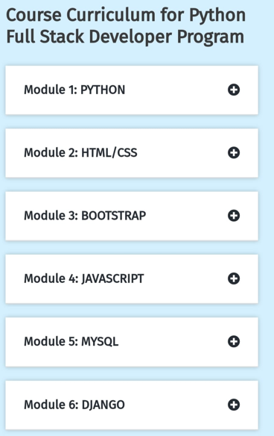

Web development:
Frontend: HTML, CSS & JAVASCRIPT, React JS
Backend Frameworks: Flask/ Django, NodeJs, ExpressJs
Mysql
Data Science:
Statistics & Python Libraries (Pandas, NumPy, scikit-learn, TensorFlow, Pytorch)
Machine Learning:
statistics, Python modules
Supervised: Regression, Decision Tree, Random Forest, Classification
Unsupervised: Unsupervised, Clustering, Association Analytics, Hidden Model
Software Development:
Data Structures and Algorithms (DSA)
OS
Networking
GIT (Version Control),
SDLC

Slide 10
Backend
Python
SQL
MySQL
PHP
Java
C
C++
C#
R
Kotlin
Data Analytics
AI
Generative AI
ChatGPT-3.5
ChatGPT-4
Google Bard
Machine Learning
DSA
Data Science
NumPy
Pandas
SciPy
Matplotlib
Statistics
Excel
Google Sheets

Slide 11
The man who asks question is a fool for a minute, a man who doesn't ask is a fool for life." ~ Confucius

Slide 12
Programming refers to a technological process to instruct a computer which tasks to perform in order to solve problems. You can think of programming as a collaboration between humans and computers, in which humans create instructions for a computer to follow (code) in a language computers can understand
Ex: Apps, Websites, Games, operating systems, Databases
difference between Scripting and Programming Languages: https://www.geeksforgeeks.org/whats-the-difference-between-scripting-and-programming-languages/

Slide 13

Who Invented Python?
Python was invented by a Dutch Programmer Guido Van Rossum in the late 1980s. Python's first version 0.9.0 was released in February 1991.
Why Python is called Python?
Python does not have any relation to Snake. The name of the Python programming language was inspired by a British Comedy Group Monty Python.

Slide 14
What is Python?
Popular programming language. (Like C, C++, Java, SQL)
Used for:
software development
system scripting
Used on a server to create web applications.
Used alongside software to create workflows.
Connects to database systems and also read and modify files.
To handle big data and perform complex mathematics.
Why Python:
works on different platforms (Windows, Mac, Linux, Raspberry Pi and so on)
simple syntax similar to the English language.
Syntax that allows developers to write programs with fewer lines than some other programming languages.
Python runs on an interpreter system, meaning that code can be executed as soon as it is written. This means that prototyping can be very quick.
Treated in a procedural way, an object-oriented way or a functional way.

Slide 15
Versions of Python
Python 1.x (1991–2000)
First release: Python 1.0 in 1991.
Included: basic data types, functions, exception handling, modules.
Not widely used outside academia/research.
Python 2.x (2000–2020)
First release: Python 2.0 (2000).
Last release: Python 2.7 (2010) – supported till Jan 2020.
Major features introduced: List comprehensions. Garbage collection (automatic memory management).Unicode support (partial).
Drawbacks: Backward compatibility issues. Inconsistent Unicode handling. End of Life (EOL): No longer maintained.
Python 3.x (2008–Present)
First release: Python 3.0 (Dec 2008).
Still actively developed and maintained.
Key differences from Python 2:
Print statement → Print function
Python 2: print "Hello“
Python 3: print("Hello")
Division behavior
Python 2: 5/2 = 2 (integer division by default)
Python 3: 5/2 = 2.5 (true division by default)
Iterators – Functions like range(), map(), filter() return iterators instead of lists.
Removed outdated features – e.g., <> as "not equal" replaced with !=.
Popular sub-versions:
Python 3.6 → introduced f-strings (formatted string literals).
Python 3.7 → data classes, context variables.
Python 3.8 → walrus operator (:=).
Python 3.9 → type hinting improvements, dictionary merge (|).
Python 3.10 → pattern matching (match-case).
Python 3.11+ → performance improvements, error messages more readable.

Slide 16
Python Installation:
C:\Users\Your Name>python or py
C:\Users\Your Name>python
Python 3.6.4 (v3.6.4:d48eceb, Dec 19 2017, 06:04:45) [MSC v.1900 32 bit (Intel)] on win32
Type "help", "copyright", "credits" or "license" for more information.
>>> print("Hello, World!")
To exit the python command line.
exit()
Download and Install Python:
Python is open-source
Python can be downloaded from the Python Software Foundation website at python.org.
Windows, Linux, mac OS / Mac OS X
open a browser and type https://www.python.org/downloads/windows/
Python Releases for Windows find the Latest Python 3 Release – Python 3.11.2 (the latest stable release as of now is Python 3.11.2).

Slide 17
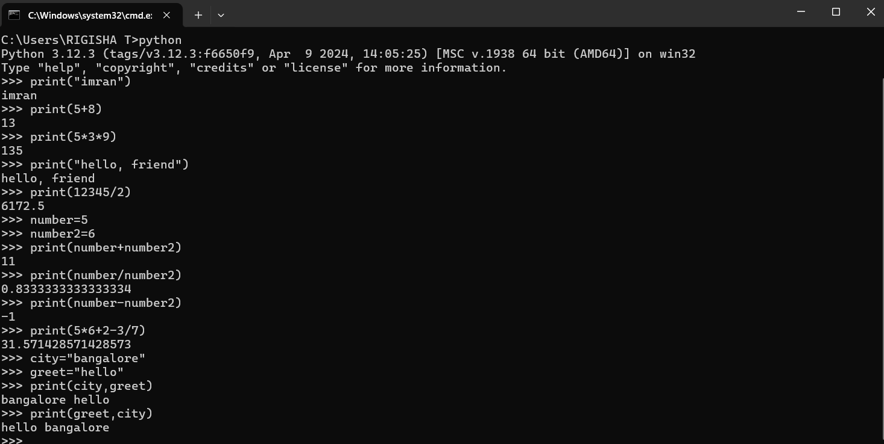

Slide 18
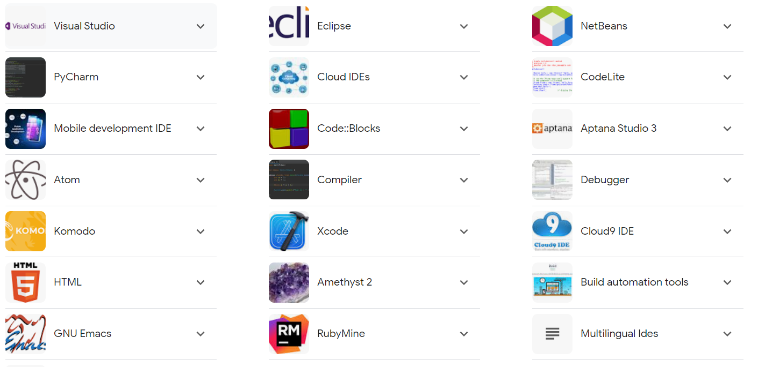
Types of IDE:
An Integrated Development Environment or IDE is a software platform that facilitates the creation of other software applications by providing a space to write, compile, and debug code, sometimes with value-adding tools that reduce development efforts.
https://www.spiceworks.com/tech/devops/articles/what-is-ide/

Slide 19
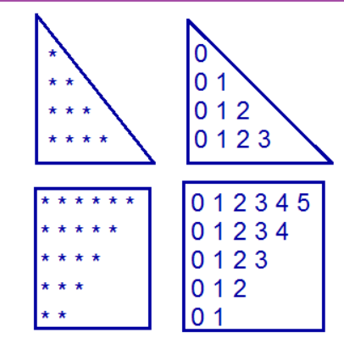
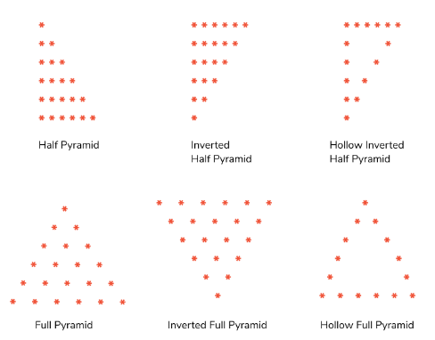
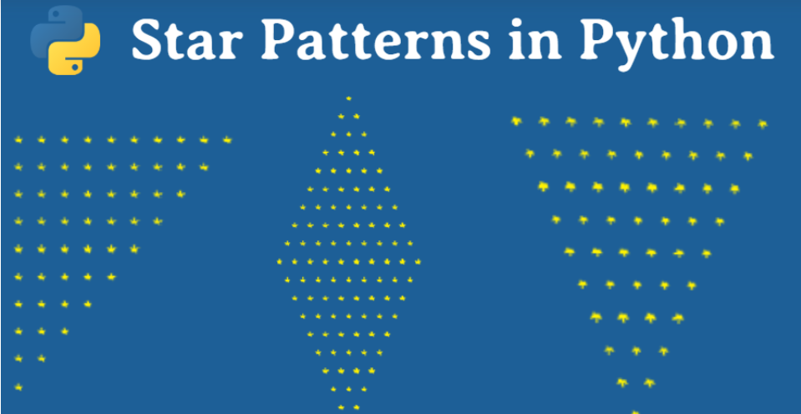
Python – Syntax
set of rules that are used to create a Python Program.
there are some definite differences between the languages.
>>> print ("Hello, World!")
Print the following programs
Name output, Mobile number, address, college name
Addition, subtraction, division, multiplication (int, float, complex)
How many feet are in a mile?
What is 1.92÷3?
Add=22, 21, 23, 22, 24, 23
Multiply=53, 53, 40, 40, 27, 27
First_complex=2+3j, Second_complex=4+6j
Program for simple interest
Program for compound interest
Program for Program to find area of a circle
Program for Program to find area of a Triangle
program to convert kilometers to miles
program to convert Celsius to Fahrenheit
https://www.tpointtech.com/python-programs

Slide 20
Print the following programs
Name output, Mobile number, address, college name

Slide 21
Features:
Interpreted: Python is processed at runtime using the interpreter. There is no need to compile a program before execution
Object-Oriented: Python follows object-oriented style and design patterns. It includes class definition with various features like encapsulation and polymorphism.
High-level language: In computer programming, a high-level language (HLL) is a programming language with strong abstraction from the details of the computer. Such languages are easier and more natural for people to use than machine code or assembly language, which require knowledge of details that are hidden from the user by the HLL. The difference between low-level and high-level programming languages is that Low-level languages are closer to machine code, which is the code that a computer executes directly. High-level languages are further from machine code and closer to natural languages like English. In general, high-level languages are less efficient in terms of memory and processing power than low-level languages because the language has to provide an abstraction for the programmer. However, this trade-off is usually worth it because high-level languages make programming easier.
General-purpose:Python is a general-purpose programming language, we mean that it is designed to be used for a wide variety of applications and tasks. It is not limited to a specific area such as web development or data analysis. Python can be used for tasks such as web development, software development, scientific computing, data analysis, artificial intelligence, automation, and more. Its versatility and ease of use make it a popular choice for many different types of programming projects.
Key Points:
It includes functional and structured programming and methods as well as object oriented programming methods.
It can be used as a scripting language or as a programming language.
It includes automatic garbage collection.
It includes high-level dynamic data types and supports various dynamic type checking.
includes a feature of integration with C, C++ and languages like Java.

Slide 22
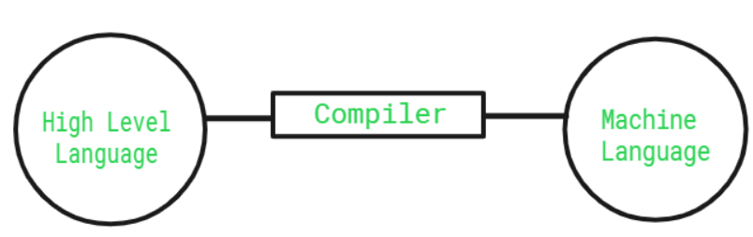
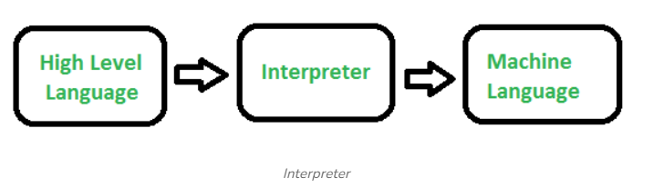
Compiled Language | Interpreted Language
Compiled language follows at least two levels to get from source code to execution. | Interpreted language follows one step to get from source code to execution.
A compiled language is converted into machine code so that the processor can execute it. | An interpreted language is a language in which the implementations execute instructions directly without earlier compiling a program into machine language.
The compiled programs run faster than interpreted programs. | The interpreted programs run slower than the compiled program.
In a compiled language, the code can be executed by the CPU. | In Interpreted languages, the program cannot be compiled, it is interpreted.
This language delivers better performance. | This language delivers slower performance.
https://youtu.be/Bj_wyqMwt58?si=h5s5Ipi5FavR5Lut
https://youtu.be/E3TDMVETp08?si=0rMawxEWih7PkPSz
https://www.youtube.com/watch?v=d7Qs-zHzQhc
https://www.youtube.com/watch?v=sv_6BXQqBc8
https://www.youtube.com/watch?v=zIjI8H945T8

Slide 23
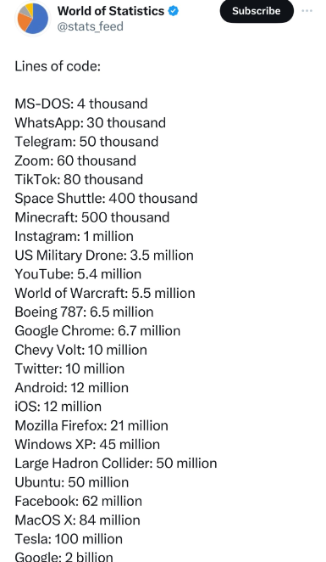
Signs to use:
In English, the symbols you mentioned are called:
( ) parentheses
‘ Single quotation
" Double Quotation
{} Curly brackets or braces
[ ] Square brackets
/ forward slash
\ Backslash
# hashtag

Slide 24
Tell me and I forget. Teach me and I remember. Involve me and I learn. Benjamin Franklin

Slide 25
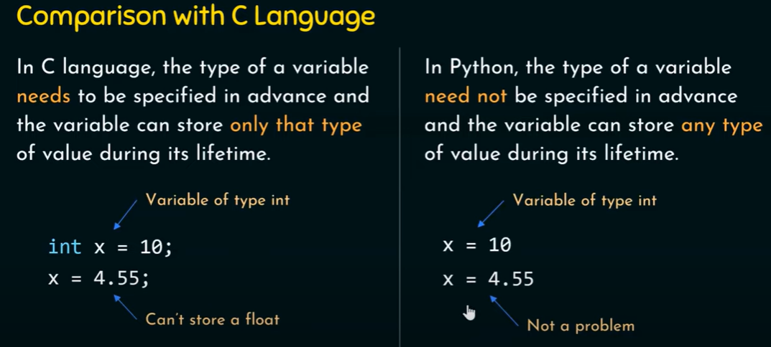
Python Variables:
Name attached to a value to reserve a memory location (data to the computer for processing)
containers for storing data values
Python has no command for declaring a variable (Like C or any other languages)
Variable is created the moment you first assign values
no need to be declared with any particular type, and can even change type after they have been set
Why variables why cant we use direct values?
https://www.youtube.com/watch?v=0Om2gYU6clE

Slide 26
Variable Names:
Variables can have a short name (x, y or z) or descriptive (my_variable, student_name)
Rules:
Must start with a letter or the underscore
Cannot start with a number
Can only contain alpha-numeric characters and underscores (A-z, 0-9, and _ )
Are case-sensitive ( Name / NAME / NaMe are three different variable types)
Variable cannot be any of the Python keywords.
Case Types:
Camel Case: myVariableName
Pascal Case: MyVariableName
Snake Case: my_variable_name
Assign Multiple Values: x, y, z = “Tomato", “Onion", “Potato“
Unpack a Collection: Vegs = [“Tomato", “onion", “potato"]: x, y, z = Vegs

Slide 27
Keyword Description
And: A logical operator
Break: To break out of a loop
Class: To define a class
Continue: To continue to the next iteration of a loop
Def: To define a function
Del: To delete an object
Elif: Used in conditional statements, same as else if
Else: Used in conditional statements
Except: Used with exceptions, what to do when an exception occurs
False: Boolean value, result of comparison operations
For: To create a for loop
From: To import specific parts of a module
Global: declare a global variable
Keyword Description
If: make a conditional statement
Import: Import a module
In: Check if a value is present in a list, tuple, etc.
Is: Test if two variables are equal
Lambda: Create an anonymous function
None: Represents a null value
Not: Logical operator
Or: Logical operator
Pass: A null statement, a statement that will do nothing
Raise: Raise an exception
Return: Exit a function and return a value
True: Boolean value, result of comparison operations
Try: Make a try...Except statement
While: Create a while loop
With: Simplify exception handling
How to check for keywords:
import keyword
print(keyword.iskeyword("hello"))
print(keyword.iskeyword("True"))

Slide 28
Built-in Data Types & Data Structures:
Text Type | Str (Python String Methods)
Numeric Types: | integers, float Numbers, complex numbers
Sequence Types: | List, Tuple, Range
Mapping Type: | Dictionary
Set Types: | Set
Boolean Type: | Bool (True / False)
Python Numbers:
Three numeric types in Python
int
float
complex
a= 1 # integer
b = 2.8 # float number
c = 1j # complex number
Note: Cannot convert complex numbers or Alphas into another number type.
Casting:
If you want to specify the data type of a variable, this can be done with casting.
Get the Type:
You can get the data type by using the type() function
String variables can be declared either by using single or double quotes
Case-Sensitive

Slide 29
User Input: Ooften need to interact with users, to get data. Most programs today use a dialog box as a way of asking the user to provide some type of input. Python provides us with inbuilt functions to read the input from the keyboard.
Ex: num = input ("Enter number :")
print(num)
name1 = input("Enter name : ")
print(name1)
Note: input() function takes all the input as a string only. Convert the input to an integer or float using int() or float() if necessary.
Ex: num = int(input ("Enter number :"))
print(num)
Ex: num = float(input ("Enter number :"))
print(num)
Ex: num = complex(input ("Enter number :"))
print(num)
https://pynative.com/python-input-and-output-exercise/
https://www.geeksforgeeks.org/input-and-output-in-python/?ref=lbp
Python check-list Before execute:
Variable Naming Rules
Value Rules
Sign rules: (),””,’’,[]
Indentation Rules
BODMAS Rules

Slide 30
Take Multiple Input in Python: Taking multiple input from the user in a single line, splitting the values entered by the user into separate variables for each value using the split() method. Then, it prints the values with corresponding labels, either two or three, based on the number of inputs provided by the user.
F-Strings: To simplify string formatting and interpolation. f-strings is introduced in Python 3.6 it provides a concise and intuitive way to embed expressions and variables directly into strings.
Ex: name = ‘Dhoni'
age = 35
print(f"Hello, My name is {name} and I'm {age} years old.")
Ex: english = 78
maths = 56
hindi = 85
print(f“Sachin got total marks {english + maths + hindi} out of 300")
# taking two inputs at a time
x, y = input("Enter two values: ").split()
print("Number of boys: ", x)
print("Number of girls: ", y)
# taking three inputs at a time
x, y, z = input("Enter three values: ").split()
print("Total number of students: ", x)
print("Number of boys is : ", y)
print("Number of girls is : ", z)

Slide 31
Python Operators:
To perform operations on variables or values.
Arithmetic operators
Assignment operators
Comparison operators
Logical operators
Identity operators
Membership operators
Bitwise operators
Arithmetic Operators:
Addition
Subtraction
Multiplication
Division
Modulus
Exponentiation
Assignment Operators:
Operator Example
= x = 9
+= x += 6
-= x -= 8
*= x *= 2
/= x /= 4
%= x %= 7
//= x //= 3
**= x **= 5
Logical Operators:
And: Returns True if both statements are True
Or: Returns True if one of the statements is True
Not: Reverse the result, returns False if the result is True

Slide 32
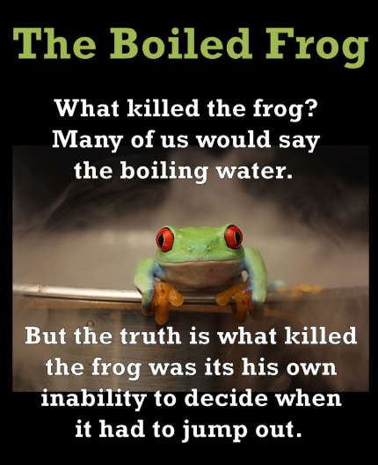
Comparison Operators:
Boolean Values:
programming we need to know if any expression is True / False
We compare two values, the expression is evaluated and Python returns the Boolean answer i.e. True/False
Ex; print(12> 15)
print(13 == 25)
print(7 < 15)
In any if condition python will return True or False
Most Values are True
Value is True if it has content.
String is True, except an empty strings
Number is True, except value 0
list, tuple, set and dictionary are True, but empty ones are false
print(bool(False)) print(bool(None)) print(bool(0)) print(bool("")) print(bool(()))
print(bool([])) print(bool({}))
Operator | Name | Example
== | Equal | x == y
!= | Not equal | x != y
> | Greater than | x > y
< | Less than | x < y
>= | Greater than or equal to | x >= y
<= | Less than or equal to | x <= y

Slide 33
Python Built in Functions:
range(), min(), max(), round(), reversed(), range(), sorted(), sum(), type(), for loop()
Range():
Returns a sequence of numbers, starting from 0 by default, and increments
by 1 (by default), and stops before a specified number (given by the user).
Start: Optional. An integer number specifying at which position to start. Default is 0
Stop: Required. An integer number specifying at which position to stop (not included).
Step: Optional. An integer number specifying the incrementation. Default is 1
Ex: Program to Display the Multiplication Table:
number=5
for count in range(1, 11):
print (number, 'x', count, '=', number * count)
Examples:
To print any range of numbers
my_range= range(6) for i in my_range: print(i)
To find min or max of any range of numbers
To reverse or sort any num/Alp
my_alph = ["a", "b", "c", "d"]
rev_alp= reversed(my_alph )
for i in rev_alp:
print(i)
To sum of all the numbers

Slide 34
Random randrange():
Returns Generating a random number has always been an important application and having
many uses in daily life. Python offers a function that can generate random numbers from a
specified range and also allowing rooms for steps to be included, called randrange() in random
module.
Random randrange():
Returns a randomly selected element from the specified range.
Start: Optional. An integer specifying at which position to start. Default 0
Stop: Required. An integer specifying at which position to end.
Step: Optional. An integer specifying the incrementation. Default 1
Examples:
Import random
print(random.randrange(0,7))
print ("Random number from 500-100 is : ",end="")
print (random.randrange(100,150))

Slide 35
Import module in Python
We can import the functions, and classes defined in a module to another module using the import statement in some
other Python source file.
Syntax to Import Module in Python: import module
Ex: from math import sqrt: print(sqrt(16))
Ex: from math import factorial: print(factorial(6))
import math
# using pi function contained in math module
Ex: print(math.pi*5)
Ex: # 60 degrees = 1.04 radians
print(math.radians(60))
Examples:
To print any range of numbers
To find min or max of any range of numbers
To reverse or sort any num/Alp
To sum of all the numbers

Slide 36
Random():
Returns a random floating number between 0 to 1
Ex: import random
print(random.random())
Random randrange() Method
returns a randomly selected element from the given range.
import random
print(random.randrange(3, 9))
For Loops
A for loop is used for iterating over a sequence (list, tuple, dictionary, set, string).
Execute a set of statements, for each item in list, tuple, set etc.
Examples:
To print any range of numbers
To find min or max of any range of numbers
To reverse or sort any num/Alp
To sum of all the numbers

Slide 37
In learning you will teach, and in teaching you will learn.”

Slide 38
Given number is even or odd?
Given number is positive or negative?
How to find the square root of a given number?
Program to Convert Centimeters to Feet and Inches?
Program to Print Table of a Given Number?
The area of a triangle
Calculate Simple Interest
Integers that Aren’t Divisible by Either 2 or 3
https://www.codesansar.com/python-programming-examples/add-two-complex-number.htm

Slide 39
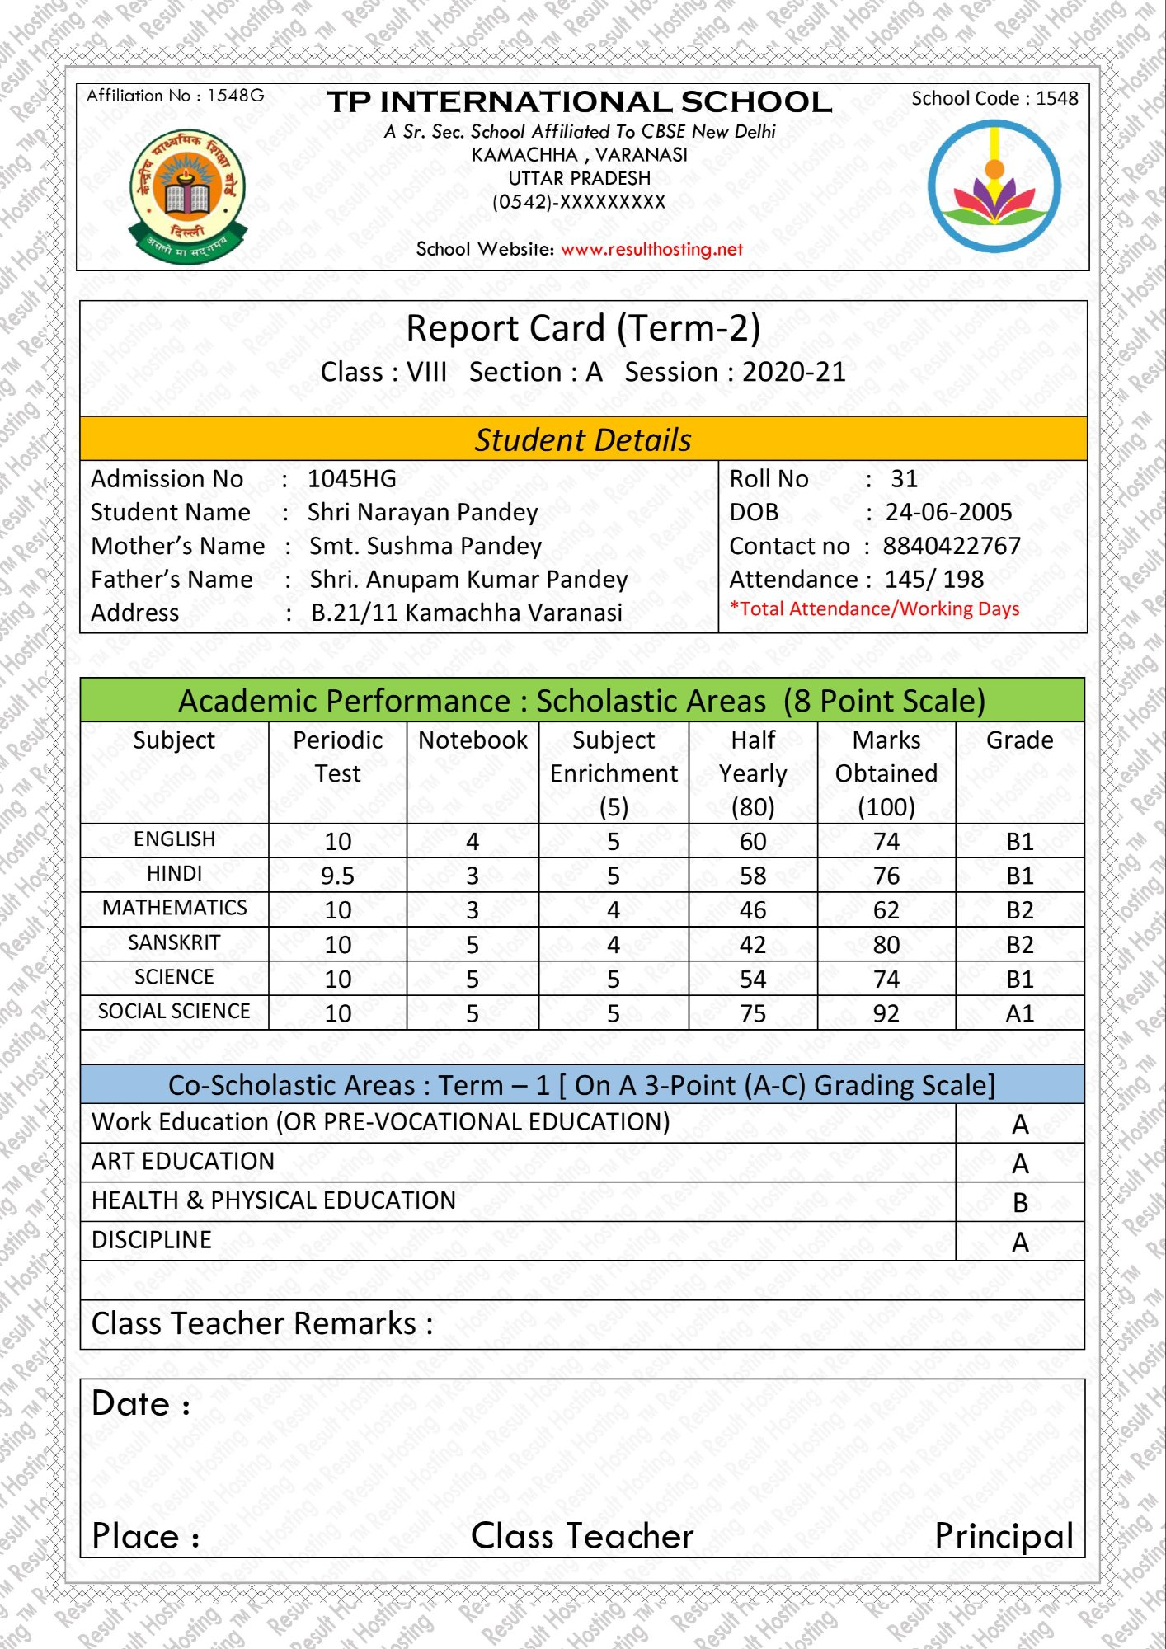
1.Hello, my name is Sachin and I am 40 years old.
2.Store three integers in x, y and z. Print their sum.
3.Store three integers in x, y and z. Print their product.
4.Store two values in x and y and swap them.
5. The value of a is 125 and b is 1015
6.Write a Python to sum all the numbers? Numbers:35,15,9845,653221,98.235,456
F-Strings:
Ex: name="Rakesh"
print(f"hello {name} how are you doing")
Ex: a = 5
b = 10
print(f"{a} plus {b} is {a + b}")

Slide 40
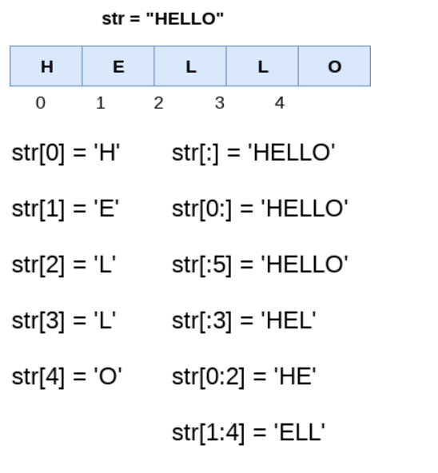
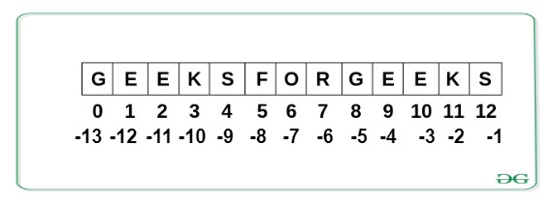
Python Strings:
surrounded by either single quotation marks, double or triple quotation marks
Assign String to a Variable
Multiline Strings: You can use three double quotes:
my_var= ""“Hello Bangalore, how are you doing today
isn’t it too hot in Bangalore these days.
Don’t worry it will rain soon""“"
Placeholders : placeholder can contain variables, operations, functions, and modifiers to format the value.
Ex: Age = 35
txt = f "age of Dhoni is {Age} years"
print(txt)
Index: Specify the start index and the end index, separated by a colon, to return any part of the string.
String:
Slicing
From the Start
Slice To the End
Negative Indexing
Features:
Strings are immutable

Slide 41
Modify Strings ( String Methods):
built-in methods that can be used on strings:
Upper Case: my_str = "Hello, Bangalore!“: print(my_str .upper())
Lower Case= print(my_str.lower())
Remove Whitespace= print(my_str.strip())
Replace String: print(my_str.replace("H", "J"))
Split String: print(my_str.split(","))
isalpha():all characters in the string are in the alphabet
isdigit(): all characters in the string are digits
String Concatenation:
To concatenate, or combine, two strings you can use the + operator
String Length:
To find out the length of the string
Split String
split() method returns a list where the text between the specified separator becomes the list items.
sentense= "Hello, bangalore ,how ,are, you, doing ,today!"
list_in=sentense.split(",")
for i in list_in:
print(i)
Concatenating
string1 = "Hello"
string2 = "Bangalore"
string3 = string1 + " " + string2
print(string3)
String Length
my_str="hello world"
print(len(my_str))

Slide 42
String Immutability (String Methods):
the string data types are immutable. Which means a string value cannot be updated once its created. other immutable data types are integers, float, Boolean. immutability of string is very useful as it helps in hashing, performance optimization, safety, ease of use.
Ex: text1= "Hello Bangalore"
print (type(text1))
text1[0] = ‘M’
Immutability is the property of an object according to which we can not change the object after we declared or after the creation of it. Some other immutable datatypes are such as strings, numbers (integers, floats, complex numbers), tuples, and frozen sets. Mutable objects are List, Dictionary, and Set.
further verify this by checking the memory location address of the position of the letters of the string. As you can see above a and a point to same location. Also N and N also point to the same location.
Ex: x = 'banana'
for idx in range (0,5):
print (x[idx], "=", id(x[idx]))

Slide 43
Benefits of Immutable Objects
Memory Efficience: Since immutable objects cannot change their value, Python can optimize memory usage. Reusing the same immutable object across the program whenever possible reduces memory overhead.
Predictability and Debugging: With immutability, you can be confident that a given object’s value will not change unexpectedly, leading to more predictable and easier-to-debug code.
Performance Optimization: Immutable objects facilitate certain performance optimizations, such as caching hash values for quick dictionary lookups.
Thread Safety: Immutability provides inherent thread safety. When multiple threads access the same immutable object, there’s no risk of data corruption due to concurrent modifications.
Hash ability and Dictionary Keys: Immutable objects can be used as keys in dictionaries because their hash value remains constant, ensuring that the key-value mapping is consistent.
Ways to Deal with Immutability
String Slicing, Reassembling and Concatenation
Using the join() method
Using String Formatting
Converting to Mutable Data Structures

Slide 44
Ways to Deal with Immutability
Formatting String by format() Method: using {} as a placeholder and then we have called.format() method
Ex: wishing="hello sachin how are you doing"
wishing[6:13]="sehwag"
print(wishing)
TypeError: 'str' object does not support item assignment
Using format method as shown below:
print('Hell {} how are you doing'.format('Sachin’))
Ex: player_name=input("enter the player name: ")
print('Hell {} how are you doing.'.format(player_name))
Index-based Insertion
Ex: print("hello Team, please find your positions team",
'Opener = {1} \n Firstdown = {3} seconddown = {2} Keeper = {0}'.format("sachin","Dhoni","raina","Ganguly"))
Ex: sentense = "My name is {} and I am {} years old.".format("Alice", 22)
print(sentense)

Slide 45
Ways to Deal with Immutability
Using the join() method: string method .join(), you call .join() on a separator string and pass an iterable of other strings as the argument. The method returns a single string, where it has inserted the separator string between each element of the iterable:
Ex: chara="hello bangalore"
join=",".join(chara)
print(join)
Ex: words = ["Time", "flies", "like", "an", "arrow!"]
print(" ".join(words))
Ex: words = ["Hello", "Bangalore", "How", "are", "you doing!"]
print(" ".join(words))
Ex: letters = ["A", "B", "C", "D"]
joined_word="".join(letters)
print(joined_word)
https://www.geeksforgeeks.org/string-formatting-in-python/

Slide 46
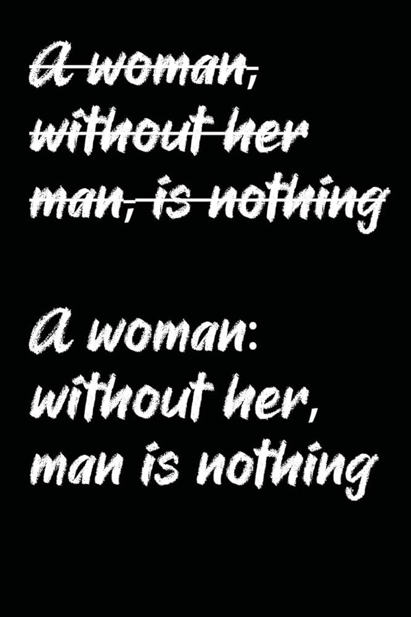
Escape Characters:
To insert characters that are invalid in a string, use an escape character.
\’ string\’ Single Quote
\\ string \\ Backslash
\n New Line
\r Carriage Return
\t Tab
\b Backspace
String Immutability
https://www.geeksforgeeks.org/why-are-python-strings-immutable/
https://www.geeksforgeeks.org/why-do-we-need-immutables-in-python/
https://www.tutorialspoint.com/python_text_processing/python_string_immutability.htm
Examples:
https://www.youtube.com/watch?v=iYCiWadRZ8I&list=PLBlnK6fEyqRiEs0J_0q5EFzk_hzpPQ0tU

Slide 47
How to repeat a string? (strin*2)
How to concatenation a string?
Comparing strings?(str==str)
Find out the input entered by user? (isalphs,isnumeric)
Sort the strings in alphabet order?

Slide 48
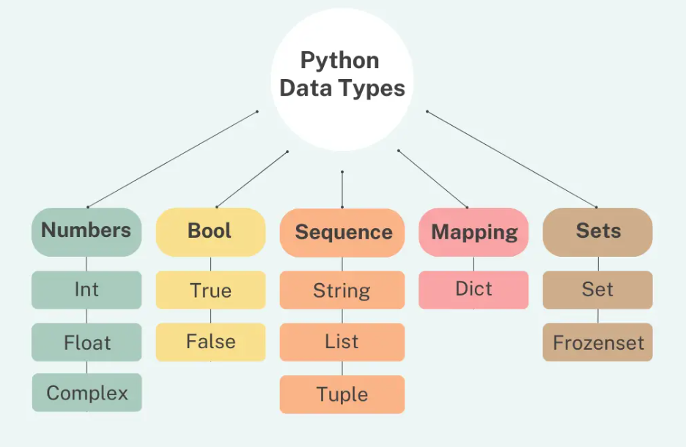
Data Types & Data Structures
What are data types?
Why to use data types?
Where to use data types?
Python comes with a number of built-in data structures, including lists, tuples, sets, and dictionaries. These data structures are essential to the Python programming environment because they provide efficient ways to store and manage data.

Slide 49
For Loops
used for iterating (repeat, or perform something again) over a sequence
(that is either a list, a tuple, a dictionary, a set, or a string)
Can execute a set of statements, once for each item in a list, tuple, set
for loop does not require an indexing.
Looping Through a String:
Strings are iterable objects, contain a sequence of characters
break statement: stop the loop before looped through all the items
https://www.kaggle.com/code/themrityunjaypathak/25-python-loop-questions-with-solutions
https://www.shiksha.com/online-courses/articles/for-loop-in-python-examples/
Examples
my_list = [“Sachin", “sehwag", “Dravid“, “Dhoni”]
My_list.append(“Kohli")
print(my_list)

Slide 50
Lists
To store multiple items in a single variable.
Efficient ways to store and manage data
One of 4 built-in data types used to store collections of data (Alphas, Numbers)
Tuple, Set, and Dictionary, all with different qualities and usage.
Lists are created using square brackets “[ ]”
Characteristics of Lists:
List items are ordered, changeable, and allow duplicate values.
Ordered:
have a defined order and will not change (If you add new items to a list,
New items will be placed at the end of the list)
Changeable:
Changeable: we can change, add, and remove items in a list after it has created.
Allow Duplicates:
Since lists are indexed, lists can have items with the same value
https://www.youtube.com/watch?v=1KLgcBcWCsE
Since it is a variable information structure, you might change any of its parts whenever they have been added.
built-in methods like append(), remove(), and insert().
A list's singular things can likewise be gotten to and changed through slicing and ordering strategies, hence proving useful in scenarios where data is constantly changing and operation heavy functions.
Ex: A shopping list is a great use for a list because you can add, remove, or modify items as needed and can be utilized to store lists of values, such as lists of names or numbers.

Slide 51
Lists:
Lists are great to use when you want to work with many related values.
They enable you to keep data together that belongs together
code, and perform the same methods and operations on multiple values at once.
Real-world Use Cases of Lists
your assortment of files, your song playlists, your emails, your browser bookmarks
the collection of videos you can access on a streaming service
Storing data sequences → marks, names, sensor readings.
Queue/stack implementations (with some limitations).
Temporary storage during computations.
Matrix or tabular data (2D lists).
Data processing in ML/AI and statistics.

Slide 52


Slide 53
Access List Items:
Items in the list are indexed and you can access with the respective
index number
The first item has index 0.
Negative Indexing
Range of Indexes
Range of Negative Indexes
Check if Item Exists
Change List Items:
change the value of a specific item, refer to the index number
Range of Item Values
Insert a new list item, using insert() function without replacing any of
the existing values
Examples
My_list = [“sachin", “sehwag", “dhoni“, “Dravid”, “ganguly”]
print(My_list [1])
Negative: print(My_list [-1])
Range: print(My_list [2:5])
Negative Range: print(My_list [-4:-1])
Change: My_list[1:3] = [“Raina", “Yuvraj"]
Insert: my_list.insert(2, “Pandya")
My_list.append(“aswin")

Slide 54
Examples
my_list = [“Sachin", “sehwag", “Dravid“, “Dhoni”]
My_list.append(“Kohli")
print(my_list)
my_list.insert(“Kohli”)
my_list.extend(my_list2)
my_list.remove(“Kohli”)
my_list.pop(1)
del my_list [0]
My_list.clear()
Add List Items:
Append: To append an item
Insert: to insert a list item at a specified index
Extend: Append elements from another list to the current list
Any Iterable: add any iterable object such as tuples, sets, dictionaries
Remove List Items:
Removes: removes the specified item (if there are more than one item,
then it removes the first occurrence)
Pop: removes the specified index value (without any index, it will remove
the list item)
Del: removes the specified index and also delete the list completely
Clear: empties the list however list still remains, but without content

Slide 55
List Comprehension: a way to create lists using a concise syntax. It allows us to generate a new list by applying an expression to each item in an existing iterable (such as a list or range). This helps us to write cleaner, more readable code compared to traditional looping techniques.
Ex: a = [2,3,4,5]
res = [val ** 2 for val in a]
print(res)
Ex: a = [1, 2, 3, 4, 5]
# Create an empty list 'res' to store results
res = []
# Iterate over each element in list 'a'
for val in a:
# Multiply each element by 2 and append it to 'res'
res.append(val * 2)
print(res)
Conditional statements in list comprehension
Ex: a = [1, 2, 3, 4, 5]
res = [val for val in a if val % 2 == 0]
print(res)
Creating a list from a range
Ex: # Creates a list of numbers from 0 to 9
a = [i for i in range(10)]
print(a)
Ex: Using nested loops:
# Creates a list of tuples representing all combinations of (x, y)
# where both x and y range from 0 to 2.
coordinates = [(x, y) for x in range(3) for y in range(3)]
print(coordinates)

Slide 56
List Methods:
append():Adds an element at the end of the list
clear(): Removes all the elements from the list
copy(): Returns a copy of the list
count(): Returns the number of elements with the specified value
extend(): Add the elements of a list (or any iterable), to the end of the current list
index(): Returns the index of the first element with the specified value
insert(): Adds an element at the specified position
pop(): Removes the element at the specified position
remove(): Removes the item with the specified value
reverse(): Reverses the order of the list
sort(): Sorts the list
nums = [10, 20, 30, 40]
Built-in Functions with Lists
print(len(nums))
print(min(nums))
print(max(nums))
print(sum(nums))
print(sorted(nums, reverse=True))

Slide 57
Updating Elements
matrix[1][1] = 99
print(matrix)
Iterating Over Nested Lists
for row in matrix:
print(row)
Element-wise iteration
for row in matrix:
for element in row:
print(element, end=" ")
Nested Lists (2D Lists)
A nested list is simply a list inside another list. It allows storing data in matrix-like or hierarchical structures.
Ex: nested = [[1, 2, 3], [4, 5, 6], [7, 8, 9]]
Why Use Nested Lists?
To represent 2D data (like tables, matrices).
To group related data together.
Useful in real-world tasks like:
Matrices in mathematics
Grids in games (like chess, Sudoku, tic-tac-toe)
Data tables (rows and columns)
Accessing Elements
Ex: matrix = [[1, 2, 3],
[4, 5, 6],
[7, 8, 9]]
print(matrix[0]) # [1, 2, 3] → first row
print(matrix[1][2]) # 6 → row 2, column 3
print(matrix[2][0]) # 7 → row 3, column 1

Slide 58
Examples
my_tuple = (“Sachin", “sehwag", “Dravid“, “Dhoni”)
print(my_tuple[1])
Tuple
To store multiple items in a single variable (Tuple items can be of any data type:)
one of 4 built-in data types in Python
Tuple is a collection which is ordered and unchangeable.
Tuples are written with round brackets.
Characteristics of Lists:
Ordered: items have a defined order, and that order will not change.
Unchangeable: can not change, add or remove items after the tuple has been created
Allow Duplicates: Tuples are indexed, they can have items with the same value
Access Tuple Items:
access items by referring to the index number
Negative Indexing
Range of Indexes: specify a range of indexes

Slide 59
Examples
my_tuple = (“Sachin", “sehwag", “Dravid“, “Dhoni”)
print(my_tuple[1])
Change Tuple Values:
Once a tuple is created, cannot change its values. Tuples are
Unchangeable/immutable (Can convert to list and changed values)
Add Items: Tuples are immutable, append() method isn’t available
Remove Items:
Tuples are unchangeable, so you cannot remove items
Tuple Methods:
count: Returns the number of times a specified value occurs in a tuple
index: Searches a specified value and returns the position
Nested Tuple
t = (1, 2, (3, 4, 5)) print(t[2])
Tuple Functions
t = (10, 20, 5, 40)
print(len(t)) # 4
print(max(t)) # 40
print(min(t)) # 5
print(sum(t)) # 75
print(sorted(t)) # [5, 10, 20, 40] (returns list, not tuple)

Slide 60
Advantages of Tuples
Faster than lists (because immutable).
Safe → Data can’t be changed accidentally.
Hashable → Tuples can be used as dictionary keys and in sets (lists cannot).
Useful for fixed collections of items (like coordinates, RGB values, database records).
Real-Life Use Cases
Coordinates / Geometrical data → (x, y)
Database records → Rows returned from SQL queries
Function return values → Functions often return tuples
Dictionary keys → When key needs multiple values
Fixed configuration values → Example: screen resolution (1920, 1080)

Slide 61
Set
Sets are used to store multiple items in a single variable.
One of 4 built-in data types in Python used to store collections of data.
Set is unordered, unchangeable, and unindexed.
To store unordered collections of unique elements.
Unordered
The items in a set do not have a defined order.
Items can appear in a different order every time you use them, and
cannot be referred to by index or key.
Unchangeable: we cannot change the items after the set has been created.
Duplicates Not Allowed: Sets cannot have two items with the same
value.
Heterogeneous → Can store different data types.
Non-indexed → Cannot access elements using indexes.
Access Items:Cannot access by referring to an index or a key
Loop through the set using ‘for’
Specified value using ‘in’
Change Items:
Cannot change its items, but can add new items.
Empty Set
s = set()
print(type(s))
Use set(), not {} (because {} creates an empty dictionary
Examples
my_team= {"Sachin","kohli", "Sehwag","Dravid","Raina","Kapila"}
Ex: print(“kohli" in
my_team)

Slide 62
Set
Add Items:
Cannot change its items, but can add new items using add()
add items from another set into the current set, use the update() method
Remove Item:
Remove: To remove an item in a set (raise error if item doesn’t exist)
Discard: To remove an item in a set (no error if item doesn’t exist)
Remove: empties the set
Del: deletes the set completely
Loop Items:
Loop through the set, and print the values
Examples
my_team= {“Sachin”,”kohli”, “Sehwag”,”Dravid”}
Add: my_team.add(“kapil”)
Update: my_team.update(new_team)
Remove: my_team.remove(“Dravid”)
Discard: my_team.discard(“Dravid”)
remove: Removes the specified element from the set. Raises an error (KeyError) if the element does not exist in the set
Discard: Removes the specified element if it exists. no error if the element is not in the set.
If you're not sure whether the element is present, use discard() — it’s safer.
If you want to ensure the element must exist (and raise an error if not), use remove().

Slide 63
Set
Join Sets:
Union() and update() methods joins all items from both sets.
Intersection() method keeps ONLY the duplicates.
Difference() method keeps the items from the first set that are not in the other set(s).
Symmetric_difference() method keeps all items EXCEPT the duplicates.
Set Methods:
add(): Adds an element to the set
clear(): Removes all the elements from the set
copy(): Returns a copy of the set
pop(): Removes an element from the set
remove(): Removes the specified element
union(): Return a set containing the union of sets
update(): Update the set with the union of this set and others
pop(): Removes random element from the set.
myset = {10, 20, 30}
item = myset.pop()
print("Removed:", item)
print("Remaining set:", myset)
a = {1, 2, 3}
b = {3, 4, 5}
print(a.union(b))
print(a.intersection(b))
print(a.difference(b))
print(a.issubset(b)) #Subset check
print(a.issuperset(b)) # Superset check
print(a.isdisjoint(b)) # True if no common elements
Set Methods ex
s = {1, 2, 3}
s.add(4)
s.update([5, 6])
s.remove(3)
s.discard(10)
s.pop():
s.clear()

Slide 64
Set
Union (OR)
a = {1, 2, 3, 4}
b = {3, 4, 5, 6}
print(a | b)
print(a.union(b))
Intersection (AND)
print(a & b)
print(a.intersection(b))
Difference
print(a - b)
print(b - a)
Examples
my_team= {“Sachin”,”kohli”, “Sehwag”,”Dravid”}
Real-Life Use Cases
Removing duplicates from a list.
Mathematical problems (union, intersection).
Membership testing (checking if item exists).
Database operations (finding common or distinct records).
Storing unique IDs (like roll numbers, usernames).

Slide 65
Set
Advantages of Set:
Unique Elements: can only contain unique elements, so they can be useful for removing duplicates from a collection of data.
Fast Membership Testing: Sets are optimized for fast membership testing, so they can be useful for determining whether a value is in a collection or not.
Mathematical Set Operations: Sets support mathematical set operations like union, intersection, and difference, which can be useful for working with sets of data.
Mutable: Sets are mutable, which means that you can add or remove elements from a set after it has been created.
Disadvantages of Sets:
Unordered: cannot rely on the order of the data in the set. This can make it difficult to access or process data in a specific order.
Limited Functionality: Have limited functionality compared to lists, as they do not support methods like append() or pop(). This can make it more difficult to modify or manipulate data stored in a set.
Memory Usage: consume more memory than lists, especially for small datasets. This is because each element in a set requires additional memory to store a hash value.
Less Commonly Used: are less commonly used than lists and dictionaries, which means that there may be fewer resources or libraries available for working with them. This can make it more difficult to find solutions to problems or to get help with debugging.
sets can be a useful data structure, especially for removing duplicates or for fast membership testing. However, their lack of ordering and limited functionality can also make them less versatile than lists or dictionaries, so it is important to carefully consider the advantages and disadvantages of using sets when deciding which data structure to use in your Python program.

Slide 66
Examples
my_team = {
“captain": “Rohit",
“vice cap": “Kohli",
“wckeeper": “Dhoni”
“leg spinner": “Chahal”
“off spinner": “Aswin”
}
print(my_team[“captain"])
print(my_team.get(“vice cap”))
print(my_team.keys())
Print(my_team.values())
Dictionaries
Data structure, used to store values in key: value format.
Makes it easier to find values.
written with curly brackets, and have keys and values
ordered, changeable and do not allow duplicates
The values in dictionary items can be of any data type
Efficient data mapping and manipulation in programming.
Changeable
Dictionaries are changeable, meaning that we can change, add or remove
items after the dictionary has been created.
Duplicates Not Allowed
Values can be of any data type and can be duplicated, whereas keys can’t be
repeated and must be immutable.
Accessing Items
Access the items of a dictionary by referring to its key using square brackets
Can also use get method.
values method will return all the values in dictionary

Slide 67
Creating Items
Creating Dictionaries
d = {"a": 1, "b": 2, "c": 3}
d = dict(x=10, y=20)
print(d)
From list of tuples
d = dict([("id", 101), ("name", "Bob")])
print(d)
Nested Dictionary
student = {
"name": "Alice",
"marks": {"math": 90, "science": 85}
}
print(student["marks"]["science"])

Slide 68
Accessing Items
Ex: my_team = {"captain": "Rohit", "vice cap": "Kohli", "wckeeper": "Dhoni", "leg spinner": "Chahal", "off spinner": "Aswin"}
Get method:
position=input("enter you key: ")
print(my_team.get(position))
Using a Loop
for i in my_team:
print(i)
keys() Method:
print(my_team.keys())
items() Method
for k,v in my_team.items():
print(f"key: {k} & value: {v}")
Nested Dictionary Access
ipl_Teams = { "KKR":{"captain": "Rohit", "vice cap": "Gambhir", "wckeeper": "Dhoni"}, "RCB":{"captain": "Kohli", "vice cap": "Gambhir", "wckeeper": "Pant", "leg spinner":"Jadeja"}}
print(ipl_Teams["RCB"]["captain"])
for team, details in ipl_Teams.items():
print(f"\nTeam: {team}")
for role, name in details.items():
print(f" {role}: {name}")
print(ipl_Teams.get("KKR").get("vice cap")) # Gambhir
print(ipl_Teams.get("MI", {}).get("captain")) # None (no error even if "MI" not present)

Slide 69
Adding Items
Direct Assignment: directly assigning a value to a key.
Ex: my_team = {"captain": "Rohit","vice cap":"Kohli"}
my_team["bowler"]="Bumrah"
print(my_team)
Adding Multiple Items: to add multiple items at once.
Ex: my_team = {"captain": "Rohit","vice cap":"Kohli"}
my_team.update({"wckeeper":"Dhoni","spinner": "Jadeja"})
print(my_team)
Using Dictionary Comprehension: add items based on conditions
Ex:d1 = {1: 10, 2: 20, 3: 30,4:40}
Add items where the key is greater than 2
d2 = {k: v * 2 for k, v in d1.items() if k > 2}
print(d2)
Using a Loop:
Ex: d = {1: 10, 2: 20, 3: 30}
for i in range(4, 6):
d[i] = i * 10 # Add new items in a loop
print(d)

Slide 70
“You can teach a student a lesson for a day; but if you can teach him to learn by creating curiosity, he will continue the learning process as long as he lives.”

Slide 71
Examples
my_team = {
“captain": “Rohit",
“vice cap": “Kohli",
“wckeeper": “Dhoni”
“leg spinner": “Chahal”
“off spinner": “Aswin”
}
my_team[“captain”]= “kohli”
my_team.update({“wckeeper”:Karthik})for x in my_team : print(x)
print(my_team[x])
for x, y in my_team.items():
print(x, y)
Dictionaries
Change Values
change the value of a item by referring its key
update the dictionary with the items from the given argument.
Removing Items
Pop method: removes the item with the specified key
Del method: removes the item with the specified key
Clear method: empties the dictionary
Loop Through a Dictionary
Loop through a dictionary by for loop to access items
Values method to return values of dictionary
Item method to loop through values and keys

Slide 72
Dictionaries
Adding Multiple Items
change the value of a item by referring its key
Ex: dict = {1: 10, 2: 20, 3: 30}
dict.update({4: 40, 5: 50})
print(dict)
setdefault() Method
d = {1: 10, 2: 20, 3: 30}
d.setdefault(3, 30)
d.setdefault(6,50)
print(d)
Note:
keys are case sensitive: same name but different cases of Key will be treated distinctly.
Keys immutable: keys can be strings, numbers, or tuples but not lists.
Keys must be unique: Duplicate keys are not allowed and any duplicate key will overwrite the previous value.
Dictionary internally uses Hashing. Hence, operations like search, insert, delete can be performed in Constant Time.
Using Dictionary Comprehension
complex scenarios where you want to add or transform items based on conditions
d1 = {1: 10, 2: 20, 3: 30}
Add items where the key is greater than 2
d2 = {k: v * 2 for k, v in data.items() if k > 2}
print(d2)
squares = {x: x*x for x in range(1, 6)}
print(squares)

Slide 73
Examples
my_team = {
“captain": “Rohit",
“vice cap": “Kohli",
“wckeeper": “Dhoni”
“leg spinner": “Chahal”
“off spinner": “Aswin”
}
my_team[“captain”]= “kohli”
my_team.update({“wckeeper”:Karthik})for x in my_team : print(x)
print(my_team[x])
for x, y in my_team.items():
print(x, y)
Dictionaries
Dictionary Methods:
clear(): Removes all the elements from the dictionary
copy(): Returns a copy of the dictionary
fromkeys(): Returns a dictionary with the specified keys and value
get(): Returns the value of the specified key
items(): Returns a list containing a tuple for each key value pair
keys(): Returns a list containing the dictionary's keys
pop(): Removes the element with the specified key
popitem(): Removes the last inserted key-value pair
update(): Updates the dictionary with the specified key-value pairs
values(): Returns a list of all the values in the dictionary
Pop
mydict = {'a': 1, 'b': 2, 'c': 3}
value = mydict.pop('b')
print("Removed value:", value)
print("Remaining dict:", mydict)
If key doesn’t exist: throws error
popitem(): Removes and returns the last inserted key-value pair as a tuple (key, value). Works like a LIFO (Last-In, First-Out) removal.
mydict = {'a': 1, 'b': 2, 'c': 3}
item = mydict.popitem()
print("Removed item:", item)
print("Remaining dict:", mydict)

Slide 74
Dictionaries
Create a dictionary of 5 students with their marks. Print only the names of students who scored more than 50.
students = {"Ravi": 45, "Anita": 67, "Kiran": 89, "Sita": 30, "Amit": 76}
for name, marks in students.items():
if marks > 50:
print(name)
Create a dictionary of 3 students with their marks. Print only the names.
students = {"Alice": 85, "Bob": 90, "Charlie": 78}
for name in students.keys():
print(name)
Write a program to find the student with the highest marks.
students = {"Alice": 85, "Bob": 92, "Charlie": 78}
topper = max(students, key=students.get)
print("Topper:", topper)
Convert two lists into a dictionary.
keys = ["id", "name", "age"]
values = [101, "John", 25]
result = dict(zip(keys, values))
print(result)
Check if a key exists in a dictionary.
student = {"name": "Alice", "age": 20, "marks": 85}
key = "marks"
if key in student:
print(f"{key} exists with value {student[key]}")
else:
print(f"{key} does not exist")
Check pass or fail for each student.
students = {"Alice": 85, "Bob": 40, "Charlie": 30}
for name, marks in students.items():
if marks >= 40:
print(f"{name} has Passed")
else:
print(f"{name} has Failed")

Slide 75
Categorize students into Grades.
students = {"Alice": 85, "Bob": 65, "Charlie": 45, "David": 30} for name, marks in students.items(): if marks >= 80: grade = "A" elif marks >= 60: grade = "B" elif marks >= 40: grade = "C" else: grade = "Fail" print(f"{name} got grade {grade}")
Apply Discount if bill > 1000.
bills = {"John": 800, "Alice": 1200, "Bob": 500, "Charlie": 2000}
for name, amount in bills.items():
if amount > 1000:
discount = amount * 0.1
final_amount = amount - discount
print(f"{name}'s bill after discount: {final_amount}")
else:
print(f"{name}'s bill: {amount}")
Check login system using dictionary.
users = {"admin": "1234", "guest": "abcd"}
username = input("Enter username: ")
password = input("Enter password: ")
if username in users and users[username] == password:
print("Login Successful")
else:
print("Invalid username or password")

Slide 76
Dictionaries
Advantages of Dictionaries
Fast lookups → Search by key is faster than lists.
Flexibility → Values can store any data type, even other dicts.
Dynamic → Keys/values can be added or removed easily.
Real-world mapping → Natural way to model structured data.
Real-Life Use Cases
Storing records → Employee database {id: details}
Word frequency counters → Counting elements in a text
Configuration settings → Key-value storage
JSON representation → APIs use dictionaries heavily
Graph adjacency list → {node: [connected_nodes]}
Use a dictionary when you need fast lookups and mapping between keys & values.
It’s one of the most powerful and widely used data structures in Python.

Slide 77
Comparison Table
When choosing a collection type, it is useful to understand the properties. Choosing the right type for a particular data set could mean an increase in efficiency and security.
 | List | Tuple | Set | Dictionary
Syntax | [ ] | ( ) | { } | { }
Mutable/Immutable | Mutable | Immutable | Mutable | Mutable
Order | Ordered | Ordered | Unordered | Unordered
Duplicates | Allowed | Allowed | Not Allowed | Not Allowed
Indexing | Allowed | Allowed | Not Allowed | Allowed
Slicing | Allowed | Allowed | Not Allowed | Not Allowed
Common Operations | append(), insert(), remove(), pop(), extend() | Concatenation, unpacking, indexing, slicing | add(), remove(), union(), intersection(), difference() | keys(), values(), items(), get()
Applications | Storing mutable sequences of items | Storing immutable sequences of items, returning multiple values from a function | Performing set operations, removing duplicates from a list | Storing key-value pairs, providing structured access to data
Limitations | Slow when dealing with large lists, takes up more memory compared to tuples | Cannot add, remove or modify elements after creation | Does not preserve order, cannot store duplicates | Keys must be unique and immutable; values can be mutable or immutable

Slide 78
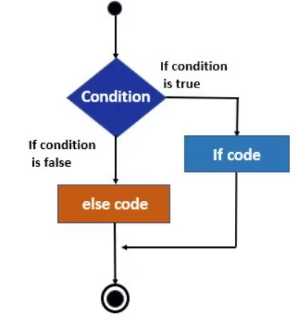
If & Else (Conditional Statements)
In programming, decision-making is crucial. If-Else statements provide a way to execute different blocks of code based on specific conditions. If-Else statements offer two paths, allowing for different outcomes depending on the condition.
Types of Control Flow
If Statement
If Else Statement
Nested If Statement
Elif
Ternary Statement | Short Hand If Else Statement
Indentation Use indentation (whitespace at the
beginning) to define scope in the code. Other
programming languages use curly-brackets for this.
syntax of the if-statement:
if expression:
statement

Slide 79
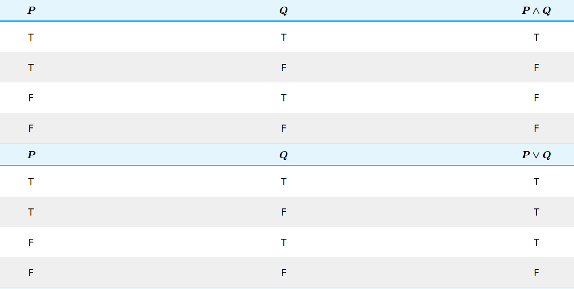
If & Else (Conditional Statements)
Python supports the logical conditions from mathematics. These conditions
can be used in several ways in "if statements" and loops.
Equals: x == y
Not Equals: x != y
Less than: x < y
Less than or equal to: x <= y
Greater than: x > y
Greater than or equal to: x >= y
if statement
In programming, the if statement is a conditional statement. It is used to
execute a block of code only when a specific condition is met
Examples
num1 = 35
num2= 85
if num1 > num2 :
print(“num1 is greater than num2")
Ex:- Age: DL, Voting, strings, input, List, Tuple, Dictionaries, credit card eligibility, even or odd, divisible by 2,

Slide 80
If & Else (Conditional Statements)
Ternary Statement | Short Hand If Else Statement
Examples
num1 = 35

Slide 81
Examples
Practice questions: ..\btoc\Python\Python Practice Question.pptx

Slide 82
Examples
x = 42
y = 56
if x > y:
print(“x is greater than y")
elif x == y:
print(“x and y are equal")
if x > y: print(“x is greater than y")
print(“x") if x > y else print(“y")
If & Else (Conditional Statements)
Elif
if the previous conditions were not true, then try this condition
Else
Anything which isn't caught by the preceding conditions
Short Hand If
If you have only one statement to execute, you can put it on the same line as
the if statement
Short Hand If ... Else
Ex: i = 10, if i < 15: print("i is less than 15")
Ex: a=6, b=2, if a > b: print("a is greater than b")
Ex: x = 2, y = 1342, print("Divisible") if y%x == 0 else print("Non-Divisible")
if elif else
if statement evaluates to false, subsequent elif statements are evaluated one
by one and comes out of the loop if any one is satisfied. Last is the else block
which will come in picture when all preceding if/elif conditions fails.

Slide 83
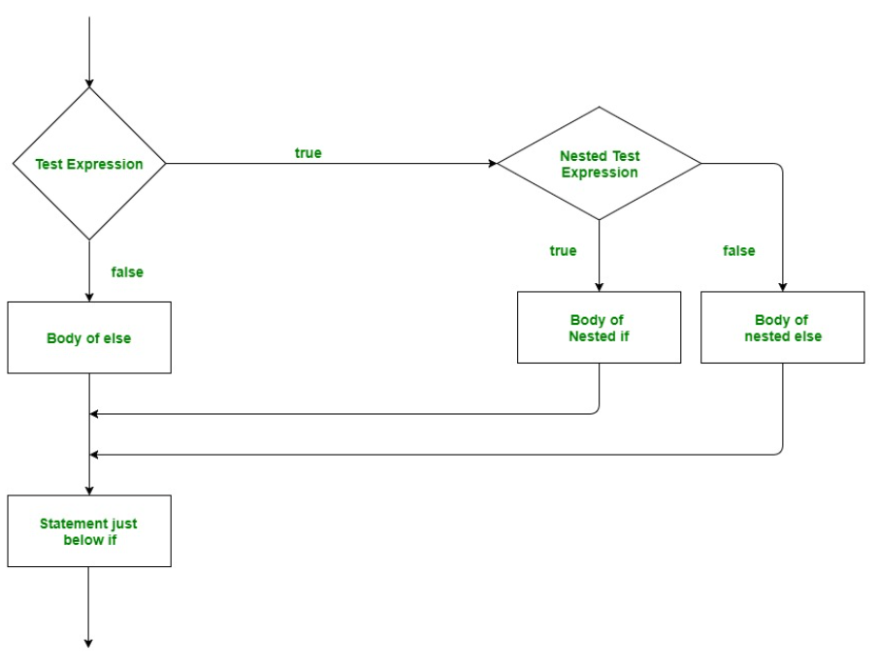
Examples
number = 5
# outer if statement
if number >= 0:
# inner if statement
if number == 0:
print('Number is 0')
# inner else statement
else:
print('Number is positive')
# outer else statement
else:
print('Number is negative')
If & Else (Conditional Statements)
Nested If
A nested if is an if statement that is the target of another if statement. Nested
if statements mean an if statement inside another if statement.

Slide 84
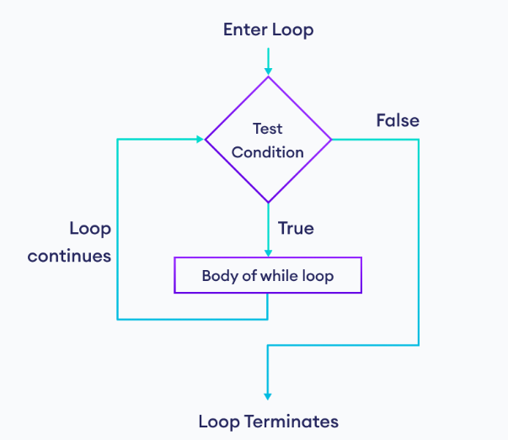
While Loops
A program needs to repeat (similar action) until something happens and you don’t know in advance when or if that something happens, we use while loop. A particular set of instructions to be executed repeatedly until a specific condition is met. Ex: music player loop
While
To execute a block of statements repeatedly until a given condition is satisfied.
Indefinite iteration: means that the number of times the loop is executed isn’t specified explicitly in advance.
While loop is executed, expr is first evaluated in a Boolean context and if it is true, the loop body is executed. Then the expr is checked again, if it is still true then the body is executed again and this continues until the expression becomes false.
While loop: Used in situations where we do not know how many times loop needs to be executed beforehand.
For loop: Used where we already know about the number of times loop needs to be executed.
Ex: i=0
While i<8:
Print(“Hello world”)
i+=1
This while loop keeps running as long as the expression i < 8 evaluates to True.

Slide 85
While Loops
‘if’ is like a gatekeeper checking a condition before letting you through once. ‘while’ is like a machine that keeps doing something as long as a condition is met. Take it another way,
if' statement: Think of a squirrel gathering nuts. The squirrel climbs a tree, finds a nut, and inspects it. If the nut is good and healthy, the squirrel will take it back to its nest. If the nut is spoiled, the squirrel leaves it behind. It's a one-time decision for each nut the squirrel encounters.
while' statement: Now, consider a beehive with bees collecting nectar. Bees fly out to flowers, collect nectar, and return to the hive. They continue this process repeatedly until they've collected enough nectar to make honey. The bees don't stop until they've gathered sufficient nectar. It's a repetitive action based on the condition of needing more nectar.
https://30dayscoding.com/blog/python-while-loop-exercises
https://csiplearninghub.com/questions-of-while-loop-in-python/
Examples
count = 0
while (count < 5):
count = count + 1
print("Hello Bengaluru, how are u doing today")
Infinite loop
age = 28
condition is always True
while age > 19:
print('Infinite Loop')

Slide 86
break, continue and pass
break, continue, and pass are flow control statements used inside loops or conditional blocks.
Purpose: Exit (terminate) the loop completely, no matter if iterations are still left. Once break is hit, the loop is abandoned.
Pass: write syntactically correct code where Python expects a statement, but don’t want to do anything yet. As a placeholder for future code
for i in range(1, 6):
if i == 3:
pass # placeholder, does nothing
print(i)
def future_function():
pass # I will implement this later
Break
for i in range(1, 6):
if i == 4:
break # stops loop when i = 3
print(i)
After break, the loop ends immediately.
students = ["Ravi", "Anu", "Kiran", "Meera"]
for name in students:
if name == "Kiran":
print("Kiran found, stop searching.")
break
print("Checking:", name)
Continue: skip only the current loop iteration and move to the next one. The loop itself continues until all iterations are done.
for i in range(1, 6):
if i % 2 == 0: # Skip even numbers
continue
print("Odd number:", i)

Slide 87
break, continue, and pass are flow control statements used inside loops or conditional blocks.
print("Welcome to the ATM")
balance = 5000 # starting balance
while True: # infinite loop until user exits
print("\nMenu:")
print("1. Check Balance")
print("2. Withdraw Money")
print("3. Deposit Money")
print("4. Future Option (Not yet ready)")
print("5. Exit")
choice = int(input("Enter your choice: "))
if choice == 1:
print("Your Balance:", balance)
elif choice == 2:
amount = int(input("Enter amount to withdraw: "))
if amount > balance:
print("Insufficient balance! Try again.")
continue # skip rest of this iteration, show menu again
balance -= amount
print("Withdrawal Successful. New Balance:", balance)
elif choice == 3:
amount = int(input("Enter amount to deposit: "))
balance += amount
print("Deposit Successful. New Balance:", balance)
elif choice == 4:
pass # placeholder (feature not implemented yet)
print("This option is coming soon...")
elif choice == 5:
print("Thank you for using the ATM. Goodbye!")
break # exit loop completely
else:
print("Invalid choice, try again.")
#######

Slide 88
“The key is not the will to win. Everybody has that. It is the will to prepare to win that is important.”

Slide 89
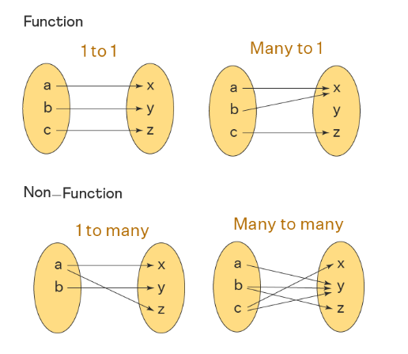
Functions
functions are defined in the mathematical sense, as a mapping from some collection of elements (i.e. a type called the domain) to another collection (i.e. a type called the codomain) with the condition that every input maps to a single output. This is all that a function can do: map values to other values.
Functions are the most important aspect of an application. A function can be defined as the organized block of reusable code which can be called whenever required.
Python allows us to divide a large program into the basic building blocks known as function.
The function contains the set of programming statements.
A function can be called multiple times to provide reusability and modularity to the python program.
In other words, we can say that the collection of functions creates a program.
Python provide us various inbuilt functions like range() or print(). Although, the user can create its functions which can be called user-defined functions
functions.pdf

Slide 90


Slide 91
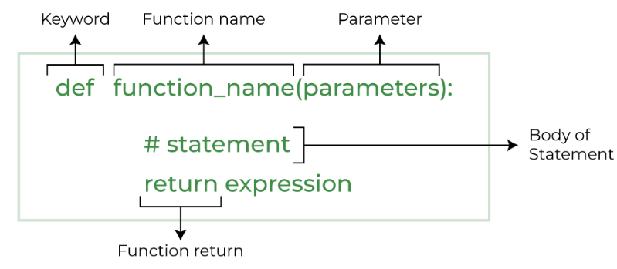
Functions
Creating a function
We can use def keyword to define the function. The syntax to define a function in python is given below.
def my_fun(): print("Hello Blore, how r u")
def greet(name):
print("Hello, " + name + ". How are you doing today?")
greet("John"), greet(“Dhoni”), greet(“Sachin”),greet(“Sachin”)
Function calling
A function must be defined before the function calling otherwise the Python interpreter gives an error. Use the function name followed by parenthesis.
def greetings(name):
print ("Hello {}".format(name)) return greetings("Sachin") greetings(“Dhoni") greetings(“Kohli")
Parameters are the variables listed inside the parentheses in the function definition.
Arguments are the values passed to the function when it is called.

Slide 92
Functions
Let’s take an example, To print a number after taking its square. Without a function
x=15
y=x**2
print(y)
Now, the same implementation using functions
Def Square(num):
y=num**2
print(y)
printSquare(15)
So far, both print the same output, no difference in code so far and even the one without function is shorter. However, pay attention to what happens now.
Suppose the requirement is changed. And you are asked to print the square of numbers 16,17 and 78 too. Lets see how the first code would do it.
x=15
y=x**2
print(y)
x=16
y=x**2
print(y)
x=17
y=x**2
print(y)
x=78
y=x**2
print(y)
Return Multiple Values
def arithmetic(num1, num2): add = num1 + num2 sub = num1 - num2 multiply = num1 * num2 division = num1 / num2 # return four values return add, sub, multiply, division # read four return values in four variables a, b, c, d = arithmetic(10, 2) print("Addition: ", a) print("Subtraction: ", b) print("Multiplication: ", c) print("Division: ", d)
def find_square(num):
result = num * num
return result
square = find_square(3)
print('Square:', square)

Slide 93
Functions
Now, look how the function implementation does it,
function printSquare(num):
y=num**2
print(y)
printSquare(15)
printSquare(16)
printSquare(17)
printSquare(78)
The code without function has redundancy, is hard to change and is not easily understandable. However, the function code is easy to grasp, easy to change, fast to grow and easy to understand. And this was just for a simple square function, you can imagine how much python functions help in coding complex logics.
Using the input with function:
num=int(input("enter your number: "))
num1=int(input("enter your number: "))
num2=int(input("enter your number: "))
num3=int(input("enter your number: "))
printSquare(num)
printSquare(num1)
printSquare(num2)
printSquare(num3)
Python range() function returns a sequence of numbers, in a given range. The most common use of it is to iterate sequences on a sequence of numbers using loops.
for i in range(8):
print(i, end=" ")
print()

Slide 94
Functions
Type & Description
Built-in functions: Python's standard library includes number of built-in functions. Some of Python's built-in functions are print(), int(), len(), sum(), etc. These functions are always available, as they are loaded into computer's memory as soon as you start Python interpreter. https://www.w3schools.com/python/python_ref_functions.asp
User-defined functions: In addition to the built-in functions and functions in the built-in modules, you can also create your own functions. These functions are called user-defined functions.
Types of arguments: Function arguments are the values or variables passed into a function when it is called. These parameters act as placeholders for the data that will be passed to the function when it is called. When the function is called, value to each of the formal arguments must be provided. Those are called actual arguments.
Positional arguments: These are passed to functions in the same order as the parameters are defined.
Keyword arguments: These are passed with the parameter name, allowing them to be in any order.
Default arguments: These have a default value if no argument is provided.
Variable-length arguments: These allow passing an arbitrary number of arguments, using *args for positional and **kwargs for keyword arguments.

Slide 95
Functions
Advantage of Functions
Code Reuse: Functions allow you to encapsulate a set of related statements into a reusable block of code. This promotes code reuse, as you can call the same function multiple times throughout your program, rather than repeating the same logic in multiple places.
Modularity: By breaking your code into smaller, well-defined functions, you can improve the modularity and organization of your programs. This makes your code easier to understand, debug, and maintain.
Abstraction: Functions provide a layer of abstraction, hiding the implementation details from the caller. This allows you to change the internal workings of a function without affecting the code that calls it, as long as the function's interface remains the same.
Parameterization: Functions can accept arguments (parameters) that allow you to make them more generic and versatile. This enables you to write functions that can operate on a wide range of input data, rather than being limited to a specific set of values.
Readability and Testability: Well-named and well-documented functions can significantly improve the readability and understandability of your code. Additionally, the ability to isolate and test individual functions makes it easier to ensure the correctness of your program.
Decomposition: Complex problems can be broken down into smaller, more manageable sub-problems, each of which can be implemented as a separate function. This divide-and-conquer approach simplifies the overall design and implementation of your program. (Login page, Landing page, Payment gateway, Logout page)
Scoping and Namespaces: Functions create their own local namespaces, which help manage variable names and avoid naming conflicts between different parts of your program.
Efficiency: Functions can be optimized and refined independently, without affecting the rest of the program. This can lead to performance improvements in your code.

Slide 96
Functions
Number of Arguments
Function must be called with the correct number of arguments. if function expects 2 arguments, you have to call the function with 2 arguments, not more, and not less. If you try to call the function with 3 or 4 arguments, you will get an error.
Ex:
def my_function (wish , city):
print(wish + " " + city)
my_function(“Hello", “Bangalore")
my_function(“Hey", “Hyderabad")
my_function(“How you doing", “Pune”)
Keyword Arguments
Arguments with the key = value. This way the order of the arguments does not matter.
Ex:
def my_function(player3, player2, player1):
print(“All rounder of the team is" + player3)
my_function(player1 = “Sachin", player2 = “Kapil", player3 = “Dhoni")
Ex:
def compound_interest(principal, rate, time, n):
amount = principal * (1 + rate/n)**(n*time)
return amount
principal = 1000
rate = 0.05
time = 10
n = 12
amount = compound_interest(principal, rate, time, n)
print(f"Compound Interest: {amount}")

Slide 97
Functions
Default Arguments
Default argument is an argument that assumes a default value if a value is not provided in the function
Ex:
def age_info( name, age = 35 ):
print ("Name: ", name)
print ("Age ", age)
return;
age_info( age=50, name=“Sachin" )
age_info( name=“Dhoni" )
Ex:
def showinfo( name, city = "Hyderabad" ):
print ("Name:", name)
print ("City:", city)
return
showinfo(name = “Kohli", city = "Delhi")
showinfo(name = "Shrey")
https://www.w3resource.com/python-exercises/python-functions-exercises.php
Calling Function Without Keyword Arguments:
def percent(phy, maths, maxmarks=200):
val = (phy + maths) * 100/maxmarks
return val
phy = 60
maths = 70
result = percent(phy, maths)
print ("percentage:", result)
phy = 40
maths = 46
result = percent(phy, maths, 100)
print ("percentage:", result)

Slide 98
Functions
Keyword VS Positional Argument
Keyword-only arguments whenever we pass the arguments(or value) by their parameter names at the time of calling the function. in which if you change the position of arguments then there will be no change in the output.
Using keyword arguments, you will get the correct output because the order of argument doesn’t matter provided the logic of your code is correct.
Ex: def nameAge(name, age):
print("Hi, I am", name)
print("My age is ", age)
nameAge(name="Prince", age=20)
nameAge(age=20, name="Prince")
Ex: def minus(a, b):
return a - b
a, b = 20, 10
result1 = minus(a, b)
print("Used Positional arguments:", result1)
# expected was (a-b) but you will be getting (b-a)
# because of swapped position of value a and b
result2 = minus(b, a)
print("Used Positional arguments:", result2)

Slide 99
Functions
*args (Arbitrary Arguments) If not known the no of arguments that will be passed in function, add * before the parameter name in the function. This way the function will receive a no of arguments.
non-keyworded, variable-length argument list
variable that we associate with the * becomes iterable
Ex: def my_function(*cities):
for i in cities:
print("The Major cities in India is " + i)
my_function("Delhi", "Mumbai", "Kolkata", "Chennai", "Bangalore")
Program to illustrate *args with a first extra argument
Python program to illustrate *args with a first extra argument
Ex: def myTeam(arg1, *argv):
print("Captain is:", arg1)
for i in argv:
print("Other team members:",i)
myTeam("sachin", "dhoni", "ganguly", “Kohli", "Rohit")
https://www.tutorialspoint.com/python/python_default_arguments.htm

Slide 100
Functions
Arbitrary Keyword Arguments, **kwargs:If not known the no of keyword arguments that will be passed in function, add two asterisk( ** )before the parameter name in the function. Function will receive a no of arguments. Double star allows us to pass through keyword arguments
A keyword argument is where you provide a name to the variable as you pass it into the function.
kwargs as being a dictionary that maps each keyword to the value that we pass alongside it.
should use the positional argument if we know the order of arguments or before using read the function you use and know the order of arguments to be passed over.
Ex: def myTeam(**kwargs):
for key,val in kwargs.items():
print(key,val)
myTeam(captain="dhoni",vicecap="sachin",midorder="raina",bowler="bumrah")

Slide 101
Functions
Function with Return Value : A
def add(x,y):
z=x+y
return z
a=10
b=20
result = add(a,b)
print ("a = {} b = {} a+b = {}".format(a, b, result))

Slide 102
Functions
Function within Functions: A function that is defined inside another function is known as the inner function or nested function. Nested functions can access variables of the enclosing scope. Inner functions are used so that they can be protected from everything happening outside the function.
Nested functions, are functions that you define inside other functions. In Python, this kind of function has direct access to variables and names defined in the enclosing function. Inner functions have many uses, most notably as closure factories and decorator functions.
Features:
Provide encapsulation and hide your functions from external access
Write helper functions to facilitate code reuse
Create closure factory functions that retain state between calls
Code decorator functions to add behavior to existing functions
Creating Nested Functions
Ex: def outer_func():
def inner_func():
print("Hello, World!")
inner_func()
outer_func()
Ex: with argument
def outer_func(who):
def inner_func():
print(f"Hello, {who}")
inner_func()
outer_func("World!")
Ex: with argument
def increment(number):
def inner_increment():
return number + 1
return inner_increment()

Slide 103
Functions
Function within Functions: A function that is defined inside another function is known as the inner function or
def has_permission(page):
def permission(username):
if username.lower() == "admin":
return f"{username}' has access to {page}."
else:
return f"{username}' doesn't have access to {page}."
return permission
check_admin_page_permision = has_permission("Admin Page")
print(check_admin_page_permision("admin"))
print(check_admin_page_permision("john"))

Slide 104
Functions
What is Scope: scope refers to the region of the program where a variable is recognized, accessed, and modified.
If you try to access a variable outside its scope NameError occurs. Scope defines the lifetime and visibility of a variable.
Global Scope: Variables declared outside any function are global. They can be accessed anywhere (inside or outside functions), but if you want to modify them inside a function, you must use global.
x = 10 # global variable
def show():
print("Inside function:", x)
show()
print("Outside function:", x)
Local Scope: Variables declared inside a function are local.
They exist only while the function runs.
def add():
y = 5 # local variable
print("Inside function:", y)
add()
print(y) #ERROR: y is local, not visible here
Modifying Global Variables (with global keyword) : Without global, Python treats the variable as local if you assign to it inside a function → causes error.
x = 10
def change():
global x # tell Python to use the global variable
x = 20
change()
print("After function:", x)
Summary:
Global variables: defined outside functions, can be read inside functions.
Local variables: defined inside functions, exist only within that function.
To modify a global variable inside a function use keyword global.

Slide 105
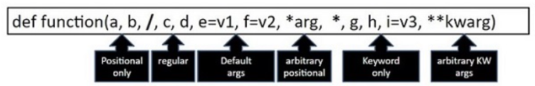
Functions
Order of Python Function Arguments: A function can have arguments of any of the types. However, the arguments must be declared in the following order
The argument list begins with the positional-only args, followed by the slash (/) symbol.
It is followed by regular positional args that may or may not be called as keyword arguments.
Then there may be one or more args with default values.
Next, arbitrary positional arguments represented by a variable prefixed with single asterisk, that is treated as tuple. It is the next.
If the function has any keyword-only arguments, put an asterisk before their names start. Some of the keyword-only arguments may have a default value.
Last in the bracket is argument with two asterisks ** to accept arbitrary number of keyword arguments.
The following diagram shows the order of formal arguments

Slide 106
Lambda
Lambda: Two ways to make functions in python: def and lambda. Lambda are anonymous functions, implying they don't have a name. Called anonymous when they are not declared in the standard manner by using the def keyword Instead, they are defined using the lambda keyword. The code is very concise so that there is more readability in the code.
Can have any number of arguments but only one expression, which is evaluated and returned.
An anonymous function cannot be a direct call to print because lambda requires an expression
Have their own local namespace and cannot access variables other than those in their parameter list and those in the global namespace.
The syntax of lambda functions contains only a single statement: lambda: argument_list : expression.
argument(s) - any value passed to the lambda function. expression - expression is executed and returned
Why: Use them as an anonymous function inside another function. lambda functions are slightly faster due to their simple, one-line syntax and lack of a formal function definition overhead. However, this performance gain is usually marginal.
mostly used in cases where needs to implement some functionality within some framework or for the purpose of providing a call back ... and where the code involved will not be re-used by other parts of a program. The reason behind the using anonymous function is for instant use, that is, one-time usage.
In Python, you're limited to lambda expressions rather than multi-statement functions. This, effectively, limits the complexity of your lambda functionality. (If you can't code it in a single Python expression (line) or it needs to perform any local name bindings (assignment) than it can't be done as a Python lambda.

Slide 107
Lambda
Ex: greet = lambda : print('Hello World’)
greet()
# lambda that accepts one argument
greet_user = lambda name : print('Hey there,', name)
# lambda call
greet_user(‘Dhoni’)
Ex: my_str = 'hello Bangalore'
upper = lambda string: string.upper()
print(upper(my_str))
Ex:add = lambda num: num + 4
print( add(6) )
Ex:x = lambda a, b : a * b
print(x(5, 6))
Ex: x = lambda a, b, c : a + b + c
print(x(5, 6, 2))
Ex: maxi = lambda x, y: x if x > y else y
maxi(4, 6)
Ex: lambda_cube = lambda y: y*y*y
print(lambda_cube(5))
Ex: Max = lambda a, b : a if(a > b) else b
print(Max(1, 2))
num1=int(input("enter you number: "))
num2=int(input("enter you number: "))
mult=lambda num1,num2:num1*num2
print(mult(num2,num1))
With lambda function | Without lambda function
Supports single-line sometimes statements that return some value. | Supports any number of lines inside a function block
Good for performing short operations/data manipulations. | Good for any cases that require multiple lines of code.
Using the lambda function can sometime reduce the readability of code. | We can use comments and function descriptions for easy readability.

Slide 108
Lambda
Lambda are more useful when we pass a function as an argument to another function. We can also use the lambda function with built-in functions such as filter, map, reduce because this function requires another function as an argument.
Ex: even numbers without lambda function
def even_numbers(nums):
even_list = []
for n in nums:
if n % 2 == 0:
even_list.append(n)
return even_list
num_list = [10, 5, 12, 78, 6, 1, 7, 9]
ans = even_numbers(num_list)
print("Even numbers are:", ans)
Ex: even number with a lambda function
l = [10, 5, 12, 78, 6, 1, 7, 9]
even_nos = list(filter(lambda x: x % 2 == 0, l))
print("Even numbers are: ", even_nos)
Ex: Code to use lambda function with if-else
Minimum = lambda x, y : x if (x < y) else y
print('The greater number is:', Minimum( 35, 74 ))
mostly used in cases where needs to implement some functionality within some framework or for the purpose of providing a call back ... and where the code involved will not be re-used by other parts of a program.

Slide 109
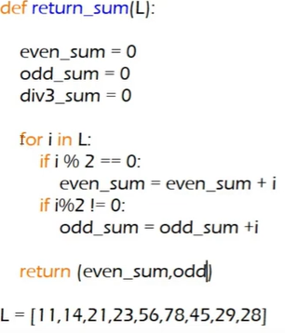
Lambda with Higher order Function
Lambda with higher order function: Contains other functions as a parameter or returns a function as an output i.e, the functions that operate with another function are known as Higher order Functions. Higher-order functions are the functions that accept other functions as arguments or return them as results and can be used as a result of this. Strong functional programming techniques like giving functions as parameters, returning functions from functions, and constructing functions on the fly are made possible by higher-order functions.
def return_sum(func,L):
result=0
for i in L:
if func(i):
result=result+i
return result
L=[11,14,21,23,56,78,45,29,28]
x=lambda x:x%2 ==0
y=lambda x:x%2 !=0
z=lambda x:x%3 ==0
print(return_sum(x,L))
print(return_sum(y,L))
print(return_sum(z,L))
Map is to translate each data item into another form.
Filter is to removed unwanted items.
Reduce is to summarize the list into a single value.
Python is an object-oriented language. The output from lambda is stored as an object at that particular memory location. To print the output, need to specify a datatype.
Let's say you specify list(). Then the output generated by the lambda function will be put in a list and presented at the output.
You can also specify any other datatype depending on the operation performed.

Slide 110
Lambda with Filter
Using lambda() Function with filter()
Filter() is a built-in function in Python. The filter function can be applied to an iterable such as a list or a dictionary and create a new iterator. The filter() method accepts two arguments :a function and an iterable such as a list.
This new iterator can filter out certain specific elements based on the condition that you provide very efficiently.
Filter() method filters the given sequence with the help of a function that tests each element in the sequence
Filter method provides a simple and efficient way to filter out elements and even takes fewer lines of code to carry out the same function.
Takes less memory and executes faster than list comprehension.
The syntax for the filter() function: filter(function, iterable (can be a set, list, tuple, dictionary, etc.))
Perfect replacement of list comprehension in terms of memory and execution time
Scenario Consider this simple scenario. Suppose, you have a list of books that contains details of more than 1000 books. Now, if you try to use a comprehensive function to filter out specific books, the process can be quite exhaustive in terms of resource utilization. The comprehensive list will create a new list and by the time it has completed its entire operation, you will have two lists in our memory. And when the lists are very large, this can cause a huge problem. Moreover, it increases the overall runtime of the processing
In contrast to this, the filter() function will simply make an object which will not be a copy of the list but will be a reference to the original list, along with the function that has been provided to filter, and the indices which have to be traversed in the original list. Needless to say, this takes less memory and executes faster than list comprehension.

Slide 111
Lambda with Filter
Using lambda() Function with filter()
Ex: Using list comprehension:
numbers = [1, 2, 3, 4, 5, 6, 7, 8, 9]
filtered_numbers = [num for num in numbers if num % 2 == 0]
print(filtered_numbers) # Output: [2, 4, 6, 8]
Ex: Using filter() with a lambda function:
numbers = [1, 2, 3, 4, 5, 6, 7, 8, 9]
filtered_numbers = list(filter(lambda x: x % 2 == 0,
print(filtered_numbers) # Output: [2, 4, 6, 8]
Ex: my_list = [35, 12, 69, 55, 75, 14, 73]
odd_list = list(filter( lambda num: (num % 2 != 0) , my_list ))
print('The list of odd number is:',odd_list)
Using filter() with a lambda function:
Ex: nums = [5, 10, 23, 64, 42, 53, 93, 2, 0, -14, 6, -22, -13]
#Filter all the odd numbers from the list
odd = filter(lambda p : p%2 != 0, nums)
#Filter all the even numbers from the list
even = filter(lambda p: p%2 == 0, nums)
print("The list of odd numbers is: ", list(odd))
print("The list of even numbers is: ", list(even))
Calling print() on a list will print the actual values of the element. Calling print on map object would print the memory the
Values.

Slide 112
Lambda with Map
Using Lambda Function with map(): Map is a function that works as an iterator to return a result after applying a function to every item of an iterable (list, Tuple etc.). It is used when to apply a single transformation function to all the iterable elements. The iterable and function are passed as arguments to the map.
syntax of the Python map() function is: map(function, iterables)
Ex: l = [1, 2, 3, 4, 5, 6]
ans = list(map(lambda x: x ** 2 if x % 2 == 0 else x ** 3, l))
print(ans)
Ex:data = [1, 2, 3, 4, 5]
squares = map(lambda x: x*x, data)
print(list(squares))
Ex: num = (6, 9, 21, 44)
resu = map(lambda i: i + i, num)
print(list(resu))
Ex: l = [1, 2, 3, 4, 5, 6]
Ex: def starts_with_A(s):
return s[0] == "A"
fruit = ["Apple", "Banana", "Pear", "Apricot", "Orange"] map_object = map(starts_with_A, fruit) print(list(map_object))
[True, False, False, True, False]
With filter()
fruit = ["Apple", "Banana", "Pear", "Apricot", "Orange"]
map_object = map(lambda s: s[0] == "A", fruit)
print(list(map_object))
Calling print() on a list will print the actual values of the element. Calling print on map object would print the memory the Values.

Slide 113
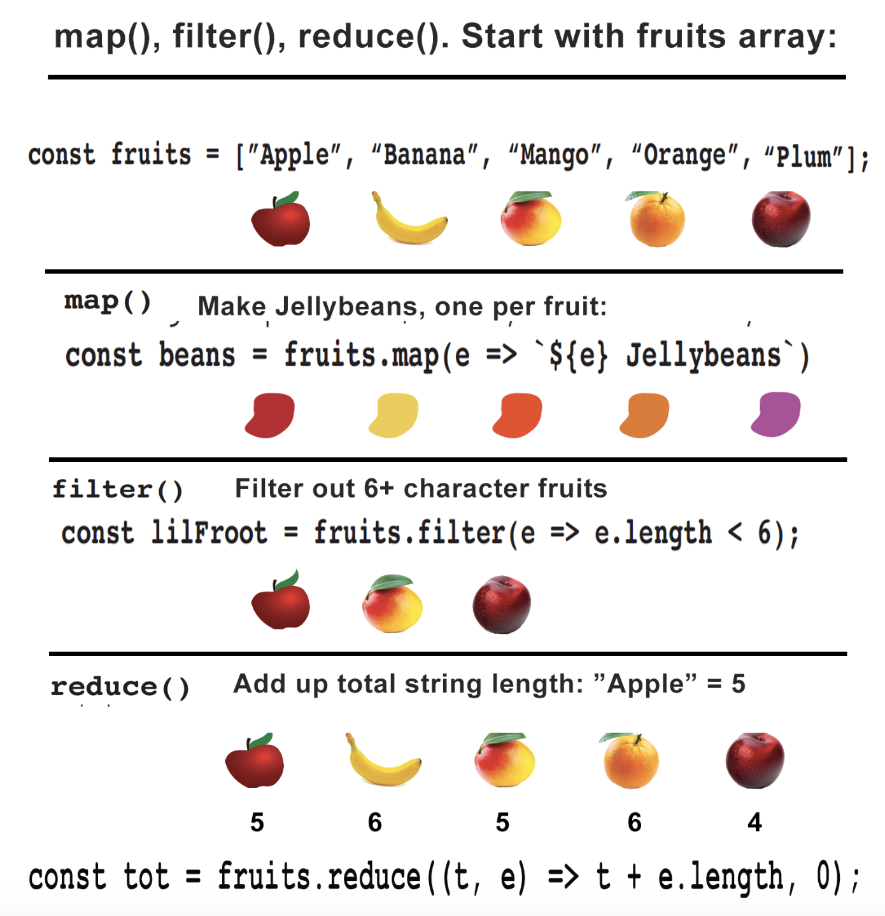
Filter vs Map
Map and Filter are among the confusing functions but important ones as well. Let's take an example to understand their difference.
Ex: map_lo=list(map(lambda var: var*2,range(0,10)))
print(map_lo)
Ex: fileter_lo=list(filter(lambda var: var*2,range(0,10)))
print(fileter_lo)
https://medium.com/@ankur.ghogle100/difference-between-map-and-filter-in-python-8c5bca11afe8
https://stackabuse.com/map-filter-and-reduce-in-python-with-examples/

Slide 114
Lambda with Reduce
Reduce in Python from the functools module is a powerful tool for performing functional computations. It continuously applies a function on a list until it returns a single value. reduce() is not part of the built-in functools module in Python 3. You need to explicitly import it if you want to use it.
Ex: from functools import reduce
l = [1, 2, 3, 4, 5, 6]
ans = reduce(lambda x, y: x * y, l)
print(ans)
Ex: lis = [1, 3, 5, 6, 2]
print(reduce(lambda a, b: a+b, lis))
print(reduce(lambda a, b: a if a > b else b, lis))
Ex: ans = reduce(lambda a, b: a + b, [1,2,6])
print(ans)
Ex: def product(x,y):
return x*y
ans = reduce(product, [2, 5, 3, 7])
print(ans)
Ex: def add(a, b):
return a + b
nums = [1, 2, 3, 4, 5]
total_sum = reduce(add, nums)
print('Total sum:', total_sum)
Ex: def multiply(a, b):
return a * b
nums = [1, 2, 3, 4, 5]
total_product = reduce(multiply, nums)
print('Total product:', total_product)
Ex: nums = [1, 2, 3, 4]
ans = reduce(lambda x, y: x + y, nums)
print(ans)
Conclusion: these are convenience functions so you can avoid writing more cumbersome code, but avoid using them too much. as it can often lead to illegible code that's hard to maintain. better to just write a slightly longer for-loop/defined method and avoid unnecessary confusion. While powerful, these functions might not always be the most readable or efficient solution. Choose the approach that best suits your specific problem and coding style. If you have a large dataset or performance is critical, explore alternative methods like list comprehensions or generator expressions, which can sometimes be more efficient.

Slide 115
Exception Handling
Exception Handling is a technique to deal with unwanted and unexpected events occurring during the program execution. one must be ready to deal with errors, unexpected inputs, or other exceptions. Using the try and except keywords, Python provides a structured approach to exception handling.
Need for Exception handling: Program terminates when ever an error occurs, sudden termination can corrupt the program, Exception may cause the data loss.
Types of errors: 1. Syntax Errors 2. Runtime Errors 3. Logical Errors
1. Syntax Errors (compile time error): occurs when the interpreter is unable to parse the code due to the code violating Python language rules, such as inappropriate indentation, erroneous keyword usage, or incorrect operator use. Syntax errors prohibit the code from running, and the interpreter displays an error message that specifies the problem and where it occurred in the code.
Ex: x = 10
if x == 10
print("x is 10")

Slide 116
Exception Handling
2. Runtime Errors: occurs when the program is executing and encounters an unexpected condition that prevents it from continuing. also known as exceptions and can occur for various reasons such as division by zero, attempting to access an index that is out of range, or calling a function that does not exist. Types of runtime errors: Runtime errors can be challenging to debug because they occur at runtime and can be difficult to reproduce. To fix a runtime error, we need to identify the cause of the error and modify the code to handle the error or avoid it altogether. Below are some specific types of runtime errors.
1. NameError: is raised when the interpreter encounters a variable or function name that it cannot find in the current scope. This can happen for a variety of reasons, such as misspelling a variable or function name, using a variable or function before it is defined, or referencing a variable or function that is outside the current scope.
Ex: def calculate_sum(a, b):
total = a + b
return total
x = 5
y = 10
z = calculate_sum(x, w)
print(z)
2. TypeError: is raised when an operation or function is applied to an object of an inappropriate type. This can happen when trying to perform arithmetic or logical operations on incompatible data types or when passing arguments of the wrong type to a function. Ex: x = "10"
y = 5
Z = x + y
print(z)

Slide 117
Exception Handling
3. IndexError: is raised when we try to access an index of a sequence (such as a string, list, or tuple) that is out of range. This can happen when we try to access an element that doesn't exist in the sequence or when we try to access an element at an index that is greater than or equal to the length of the sequence.
Ex: my_list = [100, 200, 300, 400, 500]
print(my_list[5])
4. AttributeError: is raised when you try to access an attribute or method of an object that does not exist or is not defined for that object. This can happen when you misspell the name of an attribute or method or when you try to access an attribute or method that is not defined for the type of object you are working with.
Ex: my_string = "Hello, world!“ (Elephants cant jump, crocs cant back swim)
my_string.reverse()
3. Logical Errors: occurs when the code runs without any syntax or runtime errors but produces incorrect results due to flawed logic in the code. These types of errors are often caused by incorrect assumptions, an incomplete understanding of the problem, or the incorrect use of algorithms or formulas. Unlike syntax or runtime errors, logical errors can be challenging to detect and fix because the code runs without producing any error messages. The results may seem correct, but the code might produce incorrect output in certain situations. (No Syntax Error, Unexpected Output, Difficult to Detect)
Ex: def calculate_factorial(n):
result = 1
for i in range(1, n):
result = result * i
return result
print(calculate_factorial(5))
In this example, the function calculate_factorial() is designed to calculate the factorial of a given number n. So when we run it, let's say for n = 5 , it runs without any problem but gives an output of 24 instead of 120. The reason is a logical error in the code that causes it to produce incorrect results. The for loop is iterating from 1to n-1instead of from 1 to n , causing the issue. This means that the factorial is being calculated incorrectly, resulting in an incorrect output.
Ex: def calculate_factorial(n):
result = 1
for i in range(1, n+1):
result = result * i
return result
print(calculate_factorial(5))

Slide 118
Exception Handling
These errors that are encountered frequently, the list doesn’t end here.
The following important built-in exceptions in Python.
Example of a Logical Error:
numbers = [10, 20, 30, 40, 50]
total = 0
for number in numbers:
total += number
average = total / len(numbers) - 1
print("The average is:", average)
Cause of Logical Error
The logical error is in the calculation of the average:
average = total / len(numbers) - 1
Instead, it should be:
average = total / len(numbers)
import notamodule
Traceback (most recent call last):
File "<pyshell#10>", line 1, in <module>
import notamodule
ModuleNotFoundError: No module named 'notamodule'
x=100/0
Traceback (most recent call last):
File "<pyshell#8>", line 1, in <module>
x=100/0
ZeroDivisionError: division by zero
D1={'1':"aa", '2':"bb", '3':"cc"}
D1['4']
Traceback (most recent call last):
File "<pyshell#15>", line 1, in <module>
D1['4’]
KeyError: '4’
The KeyError is thrown when a key is not found.
D1={'1':"aa", '2':"bb", '3':"cc"}
D1['4']
Traceback (most recent call last):
File "<pyshell#15>", line 1, in <module>
D1['4’]
KeyError: '4’
The KeyError is thrown when a key is not found.

Slide 119
Advantages of Exception Handling
Increased program dependability: stop your program from crashing or generating wrong results because of unforeseen faults or input.
Error handling made easier: simpler to comprehend and maintain code when separate the error management code from the core program logic using exception handling.
Simpler coding: can write code that is clearer and easier to comprehend by avoiding the use of intricate conditional expressions to check for mistakes.
Simpler debugging: interpreter generates a traceback that identifies the precise place in your code where the error happened
Disadvantages of Exception Handling
Performance penalty: interpreter must undertake an extra effort to detect and handle the exception, exception handling can be slower than utilizing conditional statements to check for mistakes.
Code complexity increase: Handling exceptions can make code more difficult, especially if you have to deal with a variety of exception types or use sophisticated error-handling logic.
Possible security risks: It's critical to manage exceptions carefully and avoid disclosing too much information about your program because improperly handled exceptions may reveal sensitive information or lead to security flaws in your code.
Best Practices for Exception Handling
Be Specific: Catch only the exceptions you expect and know how to handle them. Avoid catching overly broad exceptions like Exception or Base Exception as they might hide unexpected issues.
Avoid Bare Excepts: Don’t use a bare except statement without specifying the exception type. Always catch specific exceptions to ensure that handle the right errors.
Use Multiple Except Blocks: If different exceptions need different handling logic, use separate except blocks for each one. This makes your code more readable and maintainable.
Logging: Instead of just printing error messages, consider using the logging module to log exceptions along with relevant context information. This can be helpful for debugging in production environments.
Raising Exceptions: can raise exceptions using the raise statement. This can be useful when you encounter a condition that shouldn’t occur and want to signal an error in your code.

Slide 120
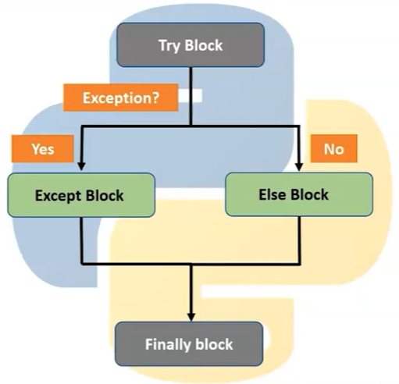
Exception Handling
Try and Except: are used to contain statements that can raise exceptions and statements that handle such exceptions. Also deal with exceptions by using the try and except commands. If the code in the try clause executes without any errors, the program will: Execute the try clause, Skip all except clauses, Continue running as normal
Ex: try block will generate an exception, because name is not defined:
try:
print(name)
except:
print("An exception occurred")
try block raises error, except block will execute. Without the try block, the program will crash and raise an error.
Ex: a = [1, 2, 3]
try:
print ("Second element = " , (a[1]))
except:
print ("An error occurred")
Ex: a=5
try:
print(a)
except:
print("exception is occurred")
Ex: a=10
b=0
Print(a/b)
Zero division error
Ex: try:
a= int(input("enter number: "))
b=int(input("enter number: "))
c=a/b
print(c)
except ZeroDivisionError:
print("cant divide the number with zero")
If the error is expected then use inbuilt exceptions (Zero, Value, Name) with except
The try block test a block of code for errors.
The except block handle the error.
The else block execute code when there is no error.
The finally block execute code, regardless the result of the try- and except blocks.

Slide 121
Exception is not Specified
Ex: x = 0
try:
print(5 / y)
except:
print("Something went wrong")
print("I am executing after the try clause!")
Exception is Specified
Ex: x = 0
try:
print(5 / x)
except ZeroDivisionError:
print("Something went wrong")
Ex: Use of multiple except clauses
print ("Handling multiple exceptions")
try:
numerator=50
denom=int(input("Enter the denominator: "))
print (numerator/denom)
print ("Division performed successfully")
except ZeroDivisionError:
print ("Denominator as ZERO is not allowed")
except ValueError:
print ("Only INTEGERS should be entered")
Ex:
try:
numerator=50
denom=int(input("Enter the denominator"))
quotient=(numerator/denom)
print(quotient)
print ("Division performed successfully")
except ZeroDivisionError:
print ("Denominator as ZERO.... not allowed")
print("OUTSIDE try..except block")
If the error is expected then use inbuilt exceptions (Zero, Value, Name) with except

Slide 122
Exception Handling
Syntax Error Vs Exceptions
Points to Remember: Can write try block without any except blocks
Can write several except blocks for a single try block
Can write multiple except blocks to handle multiple exceptions
Syntax: As the name suggests this error is caused by the wrong syntax in the code leads to the termination of program.
Ex: amount = 10000
if(amount > 2999)
print("You are eligible to purchase Dsa Self Paced")
Exceptions: are raised when the program is syntactically correct, but the code results in an error. This error does not stop the execution of the program, however, it changes the normal flow of the program.
Ex: marks = 10000
a = marks / 0
print(a)
Catching specific exceptions in the Python
Ex: try:
number = int(input("Enter a number: "))
result = 10 / number
print("The result is:", result)
except ZeroDivisionError:
print("Division by zero is not allowed.")
except ValueError:
print("Invalid input. Please enter a valid number.")
Exception Handling in Python: Try and Except Statement (scholarhat.com)
Ex: a = ["Python", "Exceptions", "try and except"]
try:
for i in range( 4 ):
print( "The index and element from the array is", i, a[i] )
#if an error occurs in the try block, then except block will be executed by the Python interpreter
except:
print ("Index out of range")
errors vs exceptions: errors are of two types, syntax errors, and logical errors. Logical errors are exceptions. That makes exceptions a specific type of error.

Slide 123
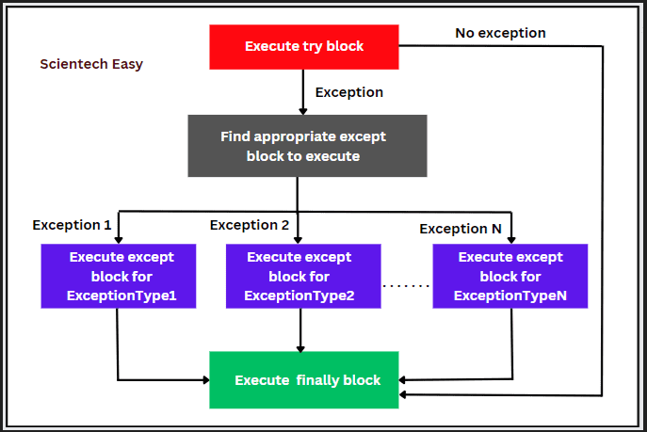
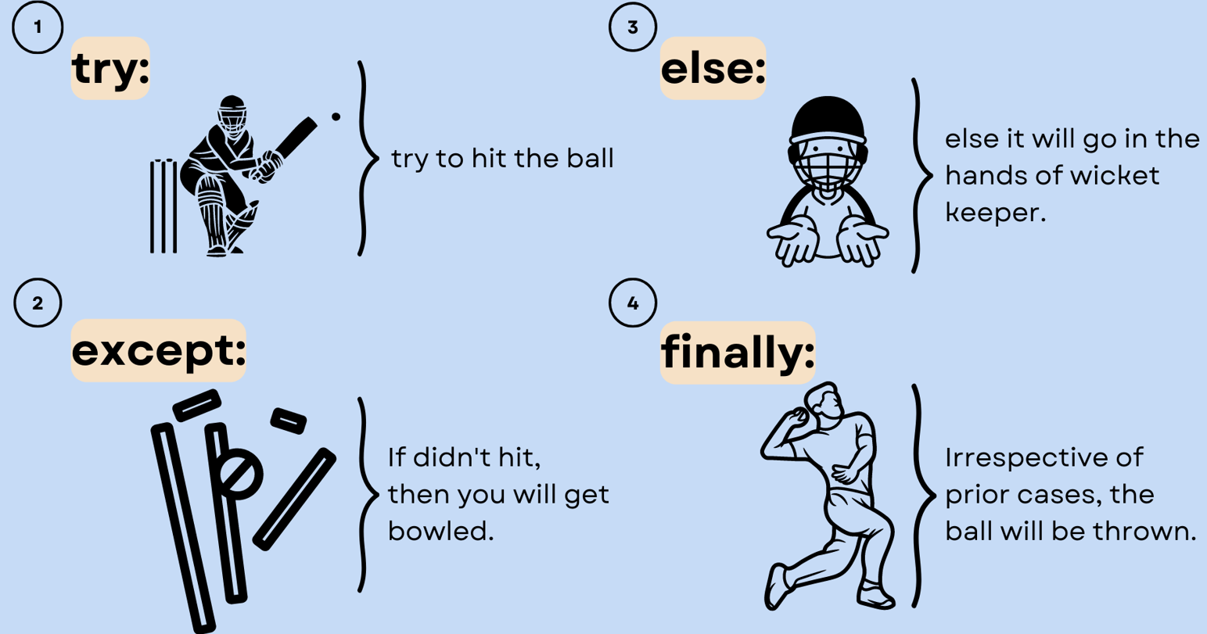
Try, except with Else: use the else clause on the try-except block which must be present after all the except clauses. code enters else block only if the try clause does not raise an exception. The else clause is simple: if the code in the try clause executes without throwing an error, then the code in the else clause will also execute.
Ex: x=5
try:
print(x)
except:
print("something went wrong")
else:
print("no error")
Ex: a=1
b=1
try:
c = ((a+b) / (a-b))
except ZeroDivisionError:
print ("a/b result in 0")
else:
print (c)
Ex: x=5, y=0
try:
result = x/y
except ZeroDivisionError:
print("Please change 'y' argument to non-zero value")
except:
print("Something went wrong")
else:
print(f"Your answer is {result}")

Slide 124
Try, except, Else with finally: always executed after the try and except blocks.
Ex: try:
k = 5//0
print(k)
except ZeroDivisionError:
print("Can't divide by zero")
finally:
print('This is always executed’)
Ex: x=5
try:
print(x)
except:
print("something went wrong")
else:
print("no error")
Finally:
Print(“execution end”)
Ex: x = 1
try:
print(5 / x)
except ZeroDivisionError:
print("I am the except clause!")
else:
print("I am the else clause!")
finally:
print("I am the finally clause!")
print("I am executing after the try clause!")

Slide 125

Raising Exception: Raising an exception refers to explicitly trigger an error condition in your program. can throw an exception and immediately halt the running of your program by using the raise keyword. The raise statement enables the programmer to compel the occurrence of a particular exception. raise keyword is used to raise an exception. can define what kind of error to raise, and the message to the user.
If you don’t find a built-in exception that semantically suits your needs, then you can define a custom one. To do this, you must inherit from another exception class, typically Exception.
Syntaxis: raise Exception(“user defined text”)
Choosing the Exception to Raise: Built-in vs Custom: should raise exceptions that clearly communicate the problem you’re dealing with. In most cases, you’ll likely find an appropriate built-in exception for your specific use case. If that’s your case, then favor the built-in exception over a custom one.
Built-in exceptions: These exceptions are built in. can use them directly in code without importing anything.
User-defined exceptions: Custom exceptions are created when no built-in exception fits your needs. typically put them in a dedicated module for a specific project.
Features of raise keyword
It helps us raise error exceptions when we may run into situations where execution can’t proceed.
It helps us raise error in Python that is caught.
Raise allows us to throw one exception at any time.
It is useful when we want to work with input validations.

Slide 126
Ex:num = -1 if num < 0: raise Exception("Sorry, no numbers below zero")
Ex: x = 56
if type(x) is not int:
raise TypeError("Only integers are allowed")
Ex:a = 5
if a % 2 != 0:
raise Exception("The number shouldn't be an odd integer")
Ex: s = "hello"
try:
num = int(s)
print(num)
except ValueError:
raise ValueError("String can't be changed into integer")
Ex: Raising Built-in Exceptions
def divide(a, b):
if b == 0:
raise ValueError("Cannot divide by zero")
print( a / b)
try:
result = divide(15, 0)
except ValueError as e:
print(e)
Ex: Raising Custom Exceptions
grades=[98, 87, 100]
total = 0
count = 0
for grade in grades:
if grade < 0 or grade > 100:
raise "grade values must be between 0 and 100 inclusive"
total += grade
count += 1
print(round(total / count, 2))
grades=[98, 87, 110]
total = 0
count = 0
for grade in grades:
if grade < 0 or grade > 100:
raise "grade values must be between 0 and 100 inclusive"
total += grade
count += 1
print(round(total / count, 2))
want to ensure that all the grades are between 0 and 100. To handle this scenario, can create a custom exception. raise this exception if a grade value is outside the target interval, meaning it’s invalid:

Slide 127
Raising Custom Exceptions: To raise your exceptions from your own methods you need to use raise keyword
def enterAge(age):
if age<0:
raise ValueError('Only positive integers are allowed')
if age % 2 ==0:
print('Entered Age is even')
else:
print('Entered Age is odd')
try:
num = int(input('Enter your age: '))
enterAge(num)
except ValueError:
print('Only positive integers are allowed')

Slide 128
Examples Questions on Error Handling
Handle Wrong Input (ValueError)
try:
age = int(input("Enter your age: "))
print("You are", age, "years old.")
except ValueError:
print(" Please enter a valid number.")
Handle File Not Found
try:
with open("unknown.txt", "r") as f:
print(f.read())
except FileNotFoundError:
print(" File does not exist.")
Error Handling with Input
def get_number(prompt):
try:
num = int(input(prompt))
except ValueError:
print(" Invalid input, please enter a number.")
return None
else:
return num
number = get_number("Enter a number: ")
if number is not None:
print("You entered:", number)

Slide 129
File Handling
so far created programs that accept the input, manipulate it and display the output. output is available only during execution of the program. variables used in a program have a lifetime that lasts till the time the program is under execution. to store the data that were input as well as the generated output permanently on disk. store Python programs written in script mode with a .py extension. Each program is stored on the secondary device as a file. Likewise, the data entered, and the output can be stored permanently into a file.
File handling is an essential concept allows to read, write, and manipulate files stored on the system. provides built-in functions to perform various file operations, such as opening, reading, writing, and closing files.
Plays an important role when the data needs to be stored permanently into the file. A file is a named location on disk to store. can access the stored information (non-volatile) after the program termination.
a file operation can be done in the following order: Create, Open, Read or Write, Close the file
Types of files: text file and binary file. text file consists of human readable characters. binary files are made up of non-human readable characters and symbols, which require specific programs to access its contents. https://www.rapidtables.com/convert/number/ascii-to-binary.html
modes for opening file:
"r" - Read -Opens a file for reading, error if the file does not exist
"a" - Append - for appending, creates the file if it does not exist
"w" - Write - for writing, creates the file if it does not exist
"x" - Create - Creates the specified file, returns an error if the file exists

Slide 130
File Handling
Create new file:
fil = open(" demofile2.txt ", "x") ->"x" - create a new file, returns an error if the file already exist else a new file is created
Write to File: open(): to open the file
fil = open("demofile2.txt", “w") -> "w" - overwrite existing content
fil.write("Welcome to file handling, you have added cotent to file")
fil.close()
Append to File: fil = open("demofile2.txt", "a") 005. FILE HANDLING.pdf
"a" - append @ end of the file
fil.write("Now the file has more content!")
fil.close()
Open existing file: starts with file open() function. accepts two arguments, file name and access mode in which the file is accessed.
Ex: Open file: fil = open("demofile.txt", "r") -> need to open file to read.
Read file: print(fil.read()) ->can read after opening
Read Parts of the File: f = open("demofile1.txt", "r") ->print(f.read(12))
Loop through the file line by line: f=open("demofile.txt", "r") -> for x in f: -> print(x)
file is located in a different location: f = open("D:\\btoc\\Python\\File Handling\\welcome.txt", "x") -> print(f.read())
Close Files: always close the file once done with it: f = open("demofile.txt", "r") -> print(f.readline()) -> f.close()
File Path:
A file path defines the location of a file or folder in the computer system. There are two ways to specify a file path.
Absolute path: which always begins with the root folder
Relative path: which is relative to the program's current working directory

Slide 131
Normal way (without with)
f = open("example.txt", "r")
data = f.read()
print(data)
f.close() # You must remember to close manually
Here you must explicitly call f.close() after you’re done.If an error occurs before f.close(), the file may stay open, leading to memory leaks, locked files, or data corruption.
Using with
with open("example.txt", "r") as f:
data = f.read()
print(data) # file is automatically closed here
with ensures the file is automatically closed, even if: An exception occurs exit the block early
readline()
with open("example.txt", "r") as f: line1 = f.readline() line2 = f.readline() print(line1, line2)
readlines()
with open("example.txt", "r") as f:
lines = f.readlines()
print(lines) # ['Hello\n', 'World\n’]
Iterating line by line
with open("example.txt", "r") as f:
for line in f:
print(line.strip()) # removes \n
Writing to Files
with open("example.txt", "w") as f:
f.write("Hello, World!\n")
f.write("This is Python file handling.")

Slide 132
File Handling
Delete file:
import os
os.remove("file3.txt")
import os
if os.path.exists("file3.txt "):
os.remove("file3.txt ")
else:
print("This file is not existed")
OS Module:
OS module for interacting with the operating system. OS comes under Python’s standard utility modules. This module provides way of using operating system-dependent functionality.
like creating files and directories, management of files and directories, input, output, environment variables, process management. Python Directories are used to store, arrange and segregate files on the system. used to manage when there are large number of files by arranging the code within different directories.
A directory, also known as a folder, is a group of files and subdirectories. The directory which is at the highest level of hierarchy that is the one that does not have a parent is called the root directory.
Current Directory: import os -> cwd = os.getcwd(), print("Current working directory:", cwd) -> get the present working directory
Creating a mark list using all the topics covered till date…User input, Data types(try most of them), if….else and while, functions, Error Handling, File Handling

Slide 133
CSV Files Handling
What is a CSV File?
CSV = Comma-Separated ValuesIt is a plain text file that stores tabular data. Each line = one record (row).Each value is separated by a delimiter (commonly ,, but can also be ;, \t, etc.).
Ex: Name,Age,City
Alice,23,Bangalore
Bob,30,Chennai
Charlie,28,Delhi
Python csv Module
Python provides the csv module for handling CSV files.
import csv
fil = open("demofile3.csv", "x")
Print(fil)
Reading CSV Files
import csv
with open("C:\\Users\\RIGISHA T\\Downloads\\mortgages_2000.csv", "r") as f:
reader = csv.reader(f)
for row in reader:
print(row)

Slide 134
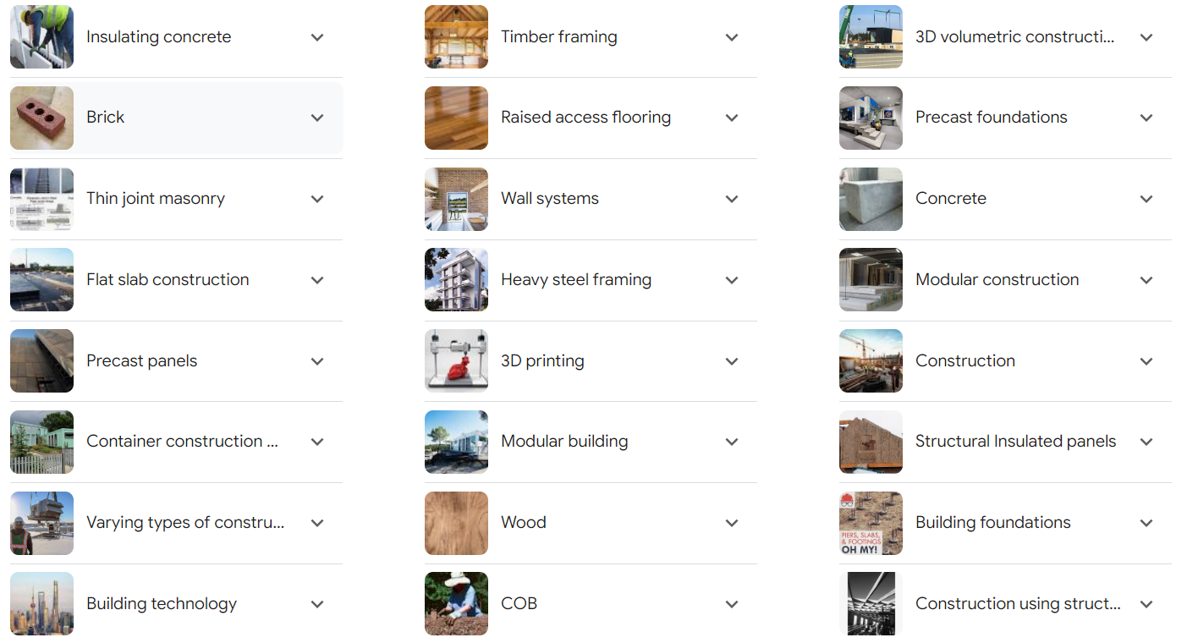

Object Oriented Programming
OOP is a style of programming. Different languages facilitate different styles of programming. The very first programming style was imperative i.e. give explicit commands to computer one after the other using machine language.
Later it was learned that structures of code like sub-routines, procedures or functions etc could be built and hence started structured programming. C language facilitates structured style of programming.
computer program = data + instructions
Problem: In structured programming, data was normally separated from procedures…especially the global data in the program could be changed by any piece of code in the software which made bug tracking in code very difficult (especially when code contained thousands of lines) because it was hard to track what changed what.
Solution: OOP seen as a solution where data and instructions were bundled into an entity called an object. Only an object would change its data and hence bug tracking became very easy. The languages that facilitate OOP include Java and C++
Saves Time
No Need to Store Materials
No Possibility of Weather Delay
Lower Volume of Waste

Slide 135
Object Oriented Programming
OOP is a way of programming using the idea of “objects” to represents data and methods. an approach used for creating neat and reusable code instead of a redundant.
Object could represent a person with properties like a name, age, and address and behaviors such as walking, talking, breathing, and running. Or it could represent an email with properties like a recipient list, subject, and body and behaviors like adding attachments and sending.
OOP is an approach for modeling concrete, real-world things, like cars, as well as relations between things, like companies and employees or students and teachers. OOP models real-world entities as software objects that have some data associated with them and can perform certain operations. organize program instructions in a better way and control program’s data efficiently.
OOPs have following features:
1. Object - Instance of Class
2. Class - Blue print of Object
Ex: lis=[12,32,65,32]
print(type(lis))
print(lis.upper)
OBJECTS
Python supports many different kinds of data
1234, 3.14159, "Hello“ [1, 5, 7, 11, 13]
{"CA": "California", "MA": "Massachusetts"}
each is an object, and every object has:
• a type
• an internal data representation (primitive or composite)
• a set of procedures for interaction with the object
an object is an instance of a type
• 1234 is an instance of an int
• "hello“ is an instance of a string
Encapsulation: wrapping or binding the data and member function into a single unit.
Data Abstraction: hiding the implementation details from the user, only the functionality will be provided to the user.
Polymorphism: assignment of more than one behavior to a particular function. The operation performed varies by the types of objects or arguments involved.
Inheritance - process of acquiring the properties or members of one class to another class.

Slide 136
Procedural Oriented Programming | Object-Oriented Programming
the program is divided into small parts called functions. | the program is divided into small parts called objects.
follows a top-down approach. | follows a bottom-up approach.
There is no access specifier in procedural programming. | has access specifiers like private, public, protected, etc.
Adding new data and functions is not easy. | Adding new data and function is easy.
does not have any proper way of hiding data so it is less secure. | provides data hiding so it is more secure.
Overloading is not possible. | Overloading is possible in object-oriented programming.
There is no concept of data hiding and inheritance. | The concept of data hiding and inheritance is used.
The function is more important than the data. | Data is more important than function.
based on the unreal world. | based on the real world.
used for designing medium-sized programs. | used for designing large and complex programs.
uses the concept of procedure abstraction. | uses the concept of data abstraction.
Code reusability absent in procedural programming | Code reusability present in object-oriented programming.
Ex: C, FORTRAN, Pascal, Basic, etc. | Ex: C++, Java, Python, C#, etc.
https://www.atatus.com/blog/programming-paradigms-compared-function-procedural-and-oop/

Slide 137
Functional vs Procedural vs OOPS
Functional | OOPS | Procedural Programming
There is no difference between data and functions; the focus is on the composition of functions. | The main focus of objects is communication among objects; they are composed of methods and attributes. | There is a difference between data and functions, with the focus on procedures (operations). Ex: a=5 b=6 print(a+b) print(a-b)
Suitable for concurrent and parallel programming | Scalable software systems are ideal | Suitable for general-purpose programming
Data are immutable for functional programming. | Hidden data and methods are possible. | Every context has access to the data, and it can be changed at any time.
In a declarative style, the developer describes what your objectives are in code | In imperative style, the developer specifies how to reach the goal through code. | This is an imperative style of programming, in which the developer specifies the code to reach the goal.
Modules and functions are used to organize code. | Objects are used to organize code. | Modules and procedures are used to organize the code.

Slide 138
Use Object Oriented Programming machine learning:
In python, there are mainly 3 programming styles 1. Object-Oriented Programming, 2. Functional Programming and 3.Procedural Programming. In simple words, there are 3 different ways to solve the problem in Python. Functional programming is most popular among data scientists as it has performance advantage. OOP is useful when you work with large codebases and code maintainability is very important.
When it comes to data manipulation and machine learning using Python, it is generally advised to study pandas, , numpy, matplotlib, scikit-learn libraries. written by experienced python developers to automate or simplify most of tasks related to data science. All these libraries depend on OOP and its concepts.
Conclusion : It's good to learn fundamentals of OOP so that you understand what's going behind the libraries you use. If you aim to be a great python developer and want to build Python library, you need to learn OOP (Must!). At the same time there are many data scientists who are unaware of OOP concepts and still excel in their job.
Advantages of oops:
Faster and easy to execute
Provides a clear structure for the programs
Easy to maintain, modify and debug
used to create full reusable applications with less code and shorter development time
Features of oops:
Class
Object
Encapsulation
Abstraction
Inheritance
Polymorphism

Slide 139
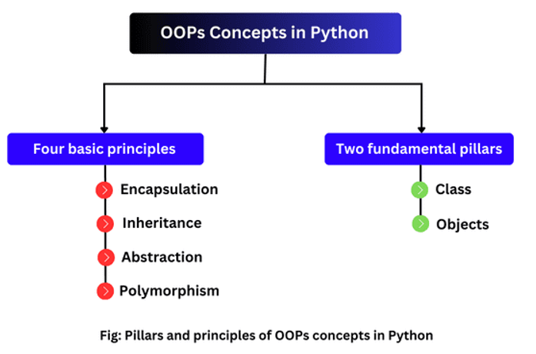
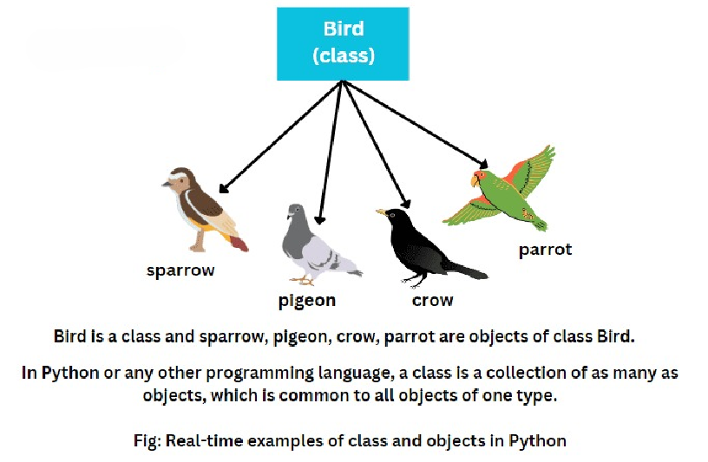
Class (OOP)
Class: can be defined as a collection of objects. a logical entity that has some specific attributes and methods. Ex: if you have an employee class, then it should contain an attribute and method, i.e. an email id, name, age, salary, etc.
why do you even need classes: consider using built-in, primitive data structures as an alternative like numbers, strings, and lists. Designed to represent straightforward pieces of information, such as the cost of an apple, the name of a poem, or your favorite colors. What if you want to represent something more complex?
For example, you might want to track employees in an organization. You need to store some basic information about each employee, such as their name, age, position, and the year they started working.
One way to do this is to represent each employee as a list:
kirk = ["James Kirk", 34, "Captain", 2265]
spock = ["Spock", 35, "Science Officer", 2254]
mccoy = ["Leonard McCoy", "Chief Medical Officer", 2266]
number of issues with this approach:
larger code files more difficult to manage
errors if employees don’t have the same number of elements in their respective lists.
A great way to make this type of code more manageable and more maintainable is to use classes.
a class is a prototype of a building. A building contains all the details about the floor, rooms, doors, windows, etc. we can make as many buildings as we want, based on these details. Hence, the building can be seen as a class, and we can create as many objects of this class.

Slide 140
Class (OOP)
Classes and Objects: class is a collection of objects or a blueprint of objects defining the common attributes and behavior.
Class is defined under a “Class” Keyword
Class Parrot:
# class attribute
name = ""
age = 0
# create parrot1 object
parrot1 = Parrot()
parrot1.name = "Blu"
parrot1.age = 10
# create another object parrot2
parrot2 = Parrot()
parrot2.name = "Woo"
parrot2.age = 15
# access attributes
print(f"{parrot1.name} is {parrot1.age} years old")
print(f"{parrot2.name} is {parrot2.age} years old")
https://www.programiz.com/python-programming/object-oriented-programming
parrot is an object. It has:
Attributes/Variables/Features/properties - name, age, color, etc.
behavior - dancing, singing, etc.
In this ex, created a class with the name Parrot with two attributes: name and age.
Then, created instances of the Parrot class. Here, parrot1 and parrot2 are references (value) to our new objects.
then accessed and assigned different values to the instance attributes using the objects name and the . notation.
Note: The variables inside a class are called attributes.
Note: class names are written in CapitalizedWords. For example, a class for a specific breed of dog, like the Jack Russell Terrier, would be written as JackRussellTerrier.

Slide 141
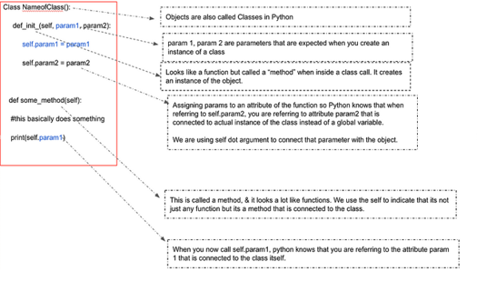
Class (OOP)
To understand this better, imagine you are a customer care executive and you are assigned the task of sending emails out to customers on a daily basis. To do this efficiently, you might want to start creating templates that can be reused.
Classes can be thought of as templates, a kind of blueprint. Only after you have filled in the details of the template and sent that email out, you can consider the task as finished. Similarly, when you create a class, you have only created the template, you still have to initialize it.
https://python.plainenglish.io/everything-about-methods-classes-in-python-6bffa1adb5d8
What are Classes? To put it simply, just grouping data based on some logic. Classes are based on objects in the real world (like Customer or Product). Other times, classes are based on concepts in our system, like HTTPRequest or Owner.
What is a Method & how is it different from a Function? When a function is defined inside a class, it is called a method. It usually performs an action and is not very different from our traditional understanding of functions. Note that we are talking of instance methods here, more on other types of methods later.
What do methods do? → Methods help you return the object, use information about the object or sometimes change the object itself. For example ( sorting on a list, counting occurrences in a tuple etc). To put it simply, they perform some action.

Slide 142
Class (OOP)
# define a class
class Bike:
name = ""
gear = 0
# create object of class
bike1 = Bike()
# access attributes and assign new values
bike1.gear = 11
bike1.name = "Mountain Bike"
print(f"Name: {bike1.name}, Gears: {bike1.gear} ")
In the above example, defined the class named Bike with two attributes: name and gear. also created an object bike1 of the class Bike.
Finally, we have accessed and modified the properties of an object using the . notation.
https://www.programiz.com/python-programming/class
https://python.plainenglish.io/everything-about-methods-classes-in-python-6bffa1adb5d8
create multiple objects from a single class.
Ex: # define a class
class Employee:
# define a property
employee_id = 0
# create two objects of the Employee class
employee1 = Employee()
employee2 = Employee()
# access property using employee1
employee1.employeeID = 1001
print(f"Employee ID: {employee1.employeeID}")
# access properties using employee2
employee2.employeeID = 1002
print(f"Employee ID: {employee2.employeeID}")
Bike - the name of the class
name/gear - variables inside the class with default values "" and 0 respectively.

Slide 143
Class (OOP)
Class called Diet_Plan that takes in the parameters 1.What food item was allowed by the dietician 2.The number of calories the patient is allowed to eat in a day.
class Diet_Plan(object):
"""A man goes to dietician and takes in the amount of calories he is allowed to eat. Diet Plan have the
following properties:
Attributes:
foodname_allowed: A string representing the food,
amount_by_dietician: A float tracking the current amount of calories that is left for him to eat during the day
"""
#thousand_ml_glass_milk_calories = 619
def __init__(self, *foodname_allowed, amount_by_dietician = 500):
self.foodname_allowed = foodname_allowed
self.amount_by_dietician = amount_by_dietician
def eat(self, total_cals_consumed, *foodeaten):
self.amount_by_dietician -= total_cals_consumed
return f"Calories that I can take for the day are {self.amount_by_dietician}“
fingers_crossed=Diet_Plan(2000,”milk”,”eggs”)
print(fingers_crossed.foodname_allowed)
fingers_crossed.eat(800,”milk”)
__init__:
__init__ is a special method (constructor) in Python classes. It is automatically called when you create (instantiate) an object of a class. It is mainly used to initialize attributes (variables) of an object.
https://python.plainenglish.io/everything-about-methods-classes-in-python-6bffa1adb5d8

Slide 144
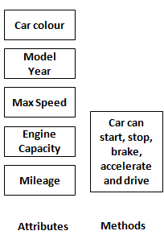
Class (OOP)
real-world examples of classes as explained below:
Recipe of Omelette is a class. Omelette is an object.
Bank Account Holder is a class. Attributes are First Name, Last Name, Date of Birth, Profession, Address etc. Methods can be "Change of address", "Change of Profession", " Change of last name" etc. "Change of last name" is generally applicable to women when they change their last name after marriage
Dog is a class. Attributes are Breed, Number of legs, Size, Age, Color etc. Methods can be Eat, Sleep, Sit, Bark, Run etc.
Ex: Create Car Class, class : car, attributes : year, mpg and speed, methods : accelerate and brake
object : car1
class car:
# attributes
year = 2016 # car model's year
mpg = 20 # mileage
speed = 100 # current speed
# methods
def accelerate(self):
print(car.speed + 20)
def brake(self):
print(car.speed – 50)
car1=car()
car1.accelerate()
car1.brake()
Create Company Class
attributes are name, turnover, revenue and number of employees working in the company. Method is revenue generated per employee (let's call it productivity for demonstration purpose). Attributes which are defined outside of method can be extracted without creating object.
# Creates class Company
class Company:
# attributes
name = "XYZ Bank"
turnover = 5000
revenue = 1000
no_of_employees = 100
# method
def productivity(self):
return Company.revenue/Company.no_of_employees
print(Company.name)
print(Company.turnover)
print(Company.no_of_employees)
Company().productivity()
https://www.listendata.com/2019/08/python-object-oriented-programming.html#basics_oop_in_python

Slide 145
Variables:
Attributes of a class are also referred to as variables. There are two kind of variables - one which is declared inside a class but outside of methods of class and the other one which is declared inside __init__.
When you use __int__ method, you can access variables only after you create a object. These variables are called Instance Variables or local variables. One which is defined outside of methods are called Class Variables or global variables. You can access these variables anywhere in the class. See the difference in the example below.
class MyCompany:
#Class Variable
growth = 0.1
def __init__(self, compname, revenue, employeesize):
#Instance Variables
self.name = compname
self.revenue = revenue
self.no_of_employees = employeesize
Wrong Way
MyCompany.revenue
Correct Way
Bank = MyCompany('DBA Bank',50000, 1000)
Print(Bank.revenue)
https://www.listendata.com/2019/08/python-object-oriented-programming.html#basics_oop_in_python
__init__:
__init__ is a special method (constructor) in Python classes. It is automatically called when you create (instantiate) an object of a class. It is mainly used to initialize attributes (variables) of an object.

Slide 146
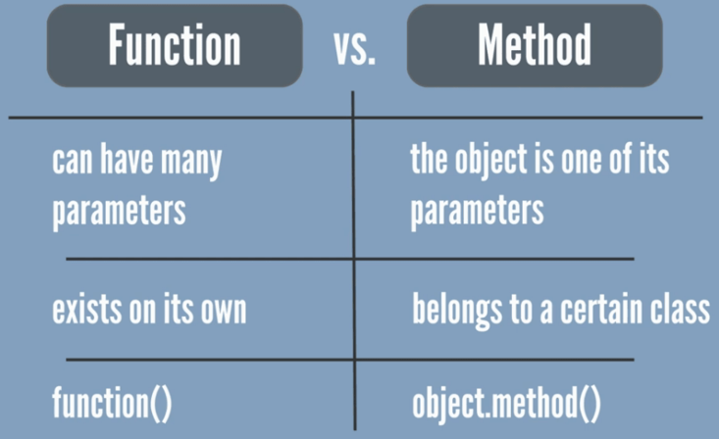
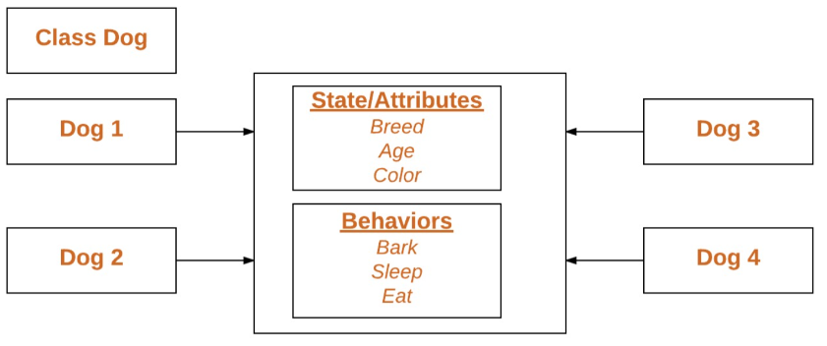
Methods (OOP)
Python Methods: can also define a function inside a Python class. A function defined inside a class is called a method. self-keyword as a first argument which allows accessing the attributes or method of the class.
# create a class
class Room:
length = 0.0
breadth = 0.0
# method to calculate area
def calculate_area(self):
print("Area of Room =", self.length * self.breadth)
# create object of Room class
study_room = Room()
# assign values to all the properties
study_room.length = 42.5
study_room.breadth = 30.8
# access method inside class
study_room.calculate_area()
https://www.programiz.com/python-programming/class
In the above ex, have created a class named Room with:
Attributes: length and breadth
Method: calculate_area()
have created an object named study_room from the Room class. then used the object to assign values to attributes: length and breadth. also used the object to call the method inside the class
study_room.calculate_area()
used the . notation to call the method. Finally, the statement inside the method is executed.
https://drive.google.com/drive/folders/16wPAyRIORMcvGEAW9ScB14-TZe_PPSDv

Slide 147
Methods (OOP)
Python Methods: there are three types of methods which are Instance, Class and Static.
Instance takes self as the first argument. They are also called Object or regular method. It's the same method which we have learnt so far in previous sections.
Class takes cls as the first argument. cls refers to class. To access a class variable within a method, we use the @classmethod decorator, and pass the class to the method
Static doesn't take anything as the first argument. It has limited uses.
How Instance and class methods are different? Instance method can access properties unique to a object or instance. Whereas Class method is used when you want to access a property of a class, and not the property of a specific instance of that class. The other difference in terms of writing style is that Instance method take self as a first parameter whereas Class method takes cls as a first parameter.
Ex: creating class for cab. Both Cab and taxi means the same thing. Attributes or properties of cab is driver name, number of kilometers run by a cab, Pick-up and drop location, cab fare and number of passengers boarded cab.
creating 3 methods : rateperkm, noofcabs, avgnoofpassengers. First one is instance method and other two are class methods.
rateperkm returns price of cab fare per km which is calculated by dividing total bill by no. of kms cab traveled.
noofcabs returns number of cabs running. Think about cab agency which owns many cabs and wants to know how many cabs are busy
avgnoofpassengers returns average number of passengers traveling in a car. To calculate average, it takes into account all the cabs running and number of passengers in each cab.
https://www.listendata.com/2019/08/python-object-oriented-programming.html

Slide 148
class Cab:
#Initialise variables for first iteration
numberofcabs = 0
numpassengers = 0
def __init__(self,driver,kms,places,pay,passengers):
self.driver = driver
self.running = kms
self.places = places
self.bill = pay
Cab.numberofcabs = Cab.numberofcabs + 1
Cab.numpassengers = Cab.numpassengers + passengers
#Returns price of cab fare per km
def rateperkm(self):
print(self.bill/self.running)
#Returns number of cabs running
@classmethod
def noofcabs(cls):
print(cls.numberofcabs)
#Returns average number of passengers travelling in a cab
@classmethod
def avgnoofpassengers(cls):
print(int(cls.numpassengers/cls.numberofcabs))
firstcab = Cab("Ramesh", 80, ['Delhi', 'Noida'], 2200, 3)
secondcab = Cab("Suresh", 60, ['Gurgaon', 'Noida'], 1500, 1)
thirdcab = Cab("Dave", 20, ['Gurgaon', 'Noida'], 680, 2)
firstcab.driver
secondcab.driver
thirdcab.driver
firstcab.rateperkm()
secondcab.rateperkm()
thirdcab.rateperkm()
Cab.noofcabs()
Cab.avgnoofpassengers()
Cab.avgnoofpassengers() returns 2 which is calculated by (3 + 1 + 2) / 3
https://www.listendata.com/2019/08/python-object-oriented-programming.html
Methods (OOP)

Slide 149
Static Methods: Static method is the least popular method among all the three methods. Unlike instance and class methods, static method does not take a special keyword (self, cls) as a first parameter. It has a limited use because Neither you can access to the properties of an instance (object) of a class NOR you can access to the attributes of the class. The only usage is it can be called without an object. It is mainly useful for creating helper or utility functions like validation of driver name (driver name must be less than 32 characters) or bill amount must be more than zero (can't be negative or zero). See the program below for the same task.
Ex:
class Cab:
@staticmethod
def billvalidation(pay):
print(int(pay) > 0)
Cab.billvalidation(0.2)

Slide 150
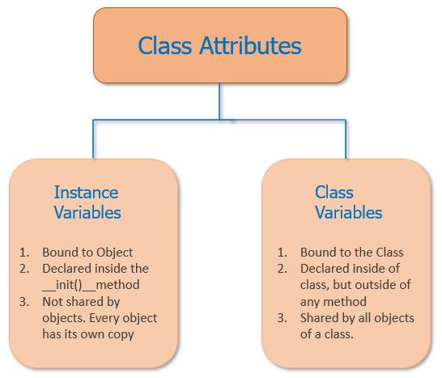
Methods (OOP)
Python methods are functions that are associated with an object or a class in Python programming. They are used to perform specific tasks or operations on the data stored within objects or classes.
methods has various uses:
used to define the behavior of the objects.
used to improve the readability and maintainability of code.
Used in breaking down complex tasks into smaller, more manageable tasks
Types of methods:
Instance methods are associated with an instance of a class and can modify the data stored within the instance.
Class methods are associated with the class rather than an instance and can access and modify class-level data.
Static methods are similar to functions outside of the class and cannot access any instance or class data.
https://www.shiksha.com/online-courses/articles/understanding-python-methods/
class Circle:
def __init__(self, radius):
self.radius = radius
def area(self):
return 3.14 * self.radius ** 2
circle1 = Circle(5)
print(circle1.area())

Slide 151
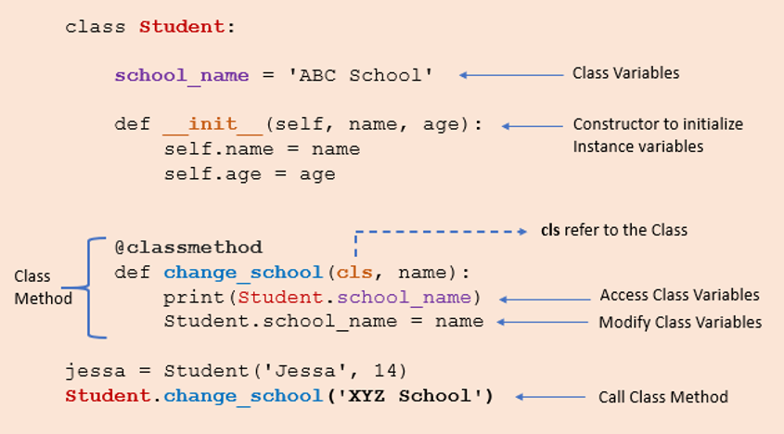
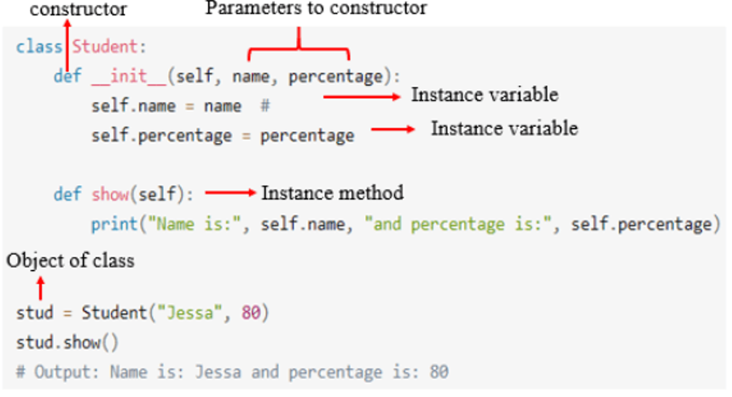
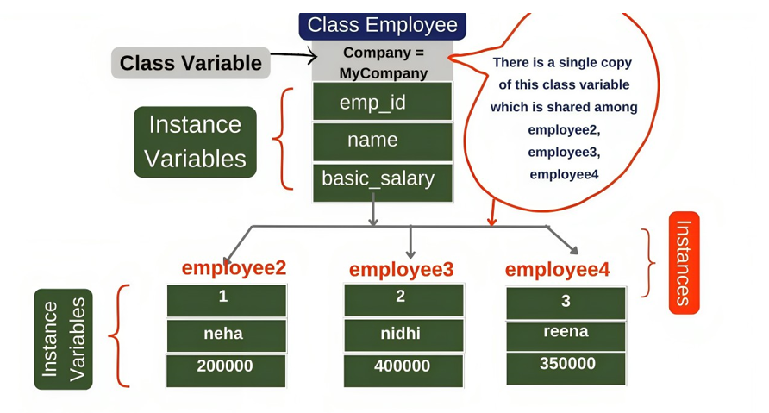
Methods (OOP)
Instance Methods Characteristics:
are defined within the class definition and are called on an instance of the class using the dot notation.
“Self” is often the first parameter of an instance method.
can access and modify the attributes of the instance on which they are called.
can also access and call other instance and class methods of the same class.
Advantages
Allow for the encapsulation of behavior specific to an instance of a class, improving code organization and making it easier to manage complex code.
are inherited by subclasses, which makes it easy to reuse code and extend functionality.
most commonly used method, and their purpose is straightforward to understand.
Disadvantages
Each class instance contains a copy of all instance variables, which can be inefficient if the class has many instances.
Instance methods are tightly coupled to the data stored within an instance, making it difficult to change the behavior of a class without affecting other classes that use that class.
often rely on an instance’s state, making them difficult to test in isolation.

Slide 152
Methods (OOP)
Ex 2: Creating a Car class to print the specifications of the particular car using instance methods.
# Define the Car class
class Car:
#Initialize the Car object with the make, model, and year
def __init__(self, make, model, year):
self.make = make
self.model = model
self.year = year
# Set the odometer reading to 0
self.odometer = 0
# Method to simulate driving the car and add to the odometer reading
def drive(self, miles):
self.odometer += miles
# Method to return the car's info including make, model, year, and odometer reading
def get_info(self):
return f"{self.year} {self.make} {self.model} with {self.odometer} miles"
"
# Create an instance of the Car class with a make of "Toyota", model of
"Corolla", and year of 2022
my_car = Car("Toyota", "Corolla", 2022)
# Simulate driving the car for 50 miles
my_car.drive(50)
# Print the car's info
print(my_car.get_info())

Slide 153
Methods (OOP)
Class Methods : Operate on the class itself rather than on an instance. Class methods are defined within the class definition and are called on the class rather than on an instance.
Characteristics
class methods are associated with the class and are defined using the @classmethod decorator.
Conventionally named “cls” and have access to class-level data.
Used to create alternative constructors that allow for easier creation of class instances with attributes set differently.
Have access to class-level variables but not instance-level variables. However, because they are associated with the class, they are often used to modify class-level data.
Advantages
can access and modify class-level data, which makes them useful for creating alternative constructors and performing operations that involve the class as a whole.
can be invoked on the class itself rather than an instance of the class, means they can be called even if no class instances have been created.
can also improve code organization by grouping related functionality in the class definition.
Disadvantages
cannot access instance-level data, which may limit their usefulness in certain situations.
also require a clear understanding of class-level and instance-level data, which can make them more complex to work with.
Overuse of class methods can also lead to tightly coupled code, which may make the code harder to maintain and test.
"

Slide 154
Ex: Employee class using class methods
class Employee:
raise_amount = 1.05 # class variable
def __init__(self, first, last, salary):
self.first = first
self.last = last
self.salary = salary
@classmethod
def set_raise_amount(cls, amount):
cls.raise_amount = amount # class method to set raise amount
emp1 = Employee("John", "Doe", 50000) # creating objects
emp2 = Employee("Jane", "Smith", 60000)
print(Employee.raise_amount)
Employee.set_raise_amount(1.10) # calling class method to set raise amount
print(Employee.raise_amount)
Ex: Employee class using class methods
import datetime
class Person:
# Define a class variable all_people as an empty list
all_people = []
# Define an instance method called __init__ that takes two arguments: name and age
def __init__(self, name, age):
self.name = name
self.age = age
# Add the instance to the all_people list
Person.all_people.append(self)
# Define a class method called from_birth_year that takes two arguments: cls and name and birth_year
@classmethod
def from_birth_year(cls, name, birth_year):
# Calculate the age based on the current year and birth year
age = datetime.date.today().year - birth_year
# Return a new instance of the Person class with the calculated age and given name
return cls(name, age)
# Create two instances of the Person class
person1 = Person("Alice", 30)
person2 = Person("Bob", 25)
# Create a new instance of the Person class using the class method from_birth_year
person3 = Person.from_birth_year("Charlie", 1990)
# Print the names and ages of all people
for person in Person.all_people:
print(person.name, person.age)

Slide 155
Methods (OOP)
Static Methods: Static methods do not take the self or “cls” parameter and cannot access the instance, class variables, or methods.
Characteristics
Are independent of instances of the class and the class itself. They don’t take any implicit first parameter like self or cls.
Can’t access class-level data or instance-level data. work like normal functions outside of the class and have no access to data except the data passed as arguments.
To define a static method, must use the @staticmethod decorator before the method definition.
Are often utilized for utility functions that don’t depend on any data of the class or instance. They can be used to perform calculations or operations related to the class but not dependent on it.
Advantages
can execute operations independent of a specific instance or the class.
can be called without creating an instance of the class, making them more memory-efficient than instance methods in cases where only a specific functionality is required.
can be easily tested and mocked since they do not rely on the state of a specific instance or the class itself.
Disadvantages
cannot access the instance or class, they cannot modify any instance or class-level data.
Are less flexible than instance and class methods since they cannot be overridden in subclasses.
may not provide a clear separation between the functionality that should be part of the class and the functionality that standalone functions should provide.
"

Slide 156
Ex: class MathOperations:
# Static method that adds two numbers
@staticmethod
def add_numbers(num1, num2):
return num1 + num2
# Static method that multiplies two numbers
@staticmethod
def multiply_numbers(num1, num2):
return num1 * num2
# Static method that computes the factorial of a number
@staticmethod
def factorial(num):
if num == 0:
return 1
else:
return num * MathOperations.factorial(num - 1)
# Example usage
print(MathOperations.add_numbers(2, 3))
print(MathOperations.multiply_numbers(4, 5))
print(MathOperations.factorial(4))
Ex:
class Math:
# Define a static method named "add_numbers" that takes two parameters "x" and "y"
@staticmethod
def add_numbers(x, y):
# Returns the sum of the two numbers
return x + y
#Create an instance of the Math class and call the "add_numbers" method, passing in two arguments
print(Math.add_numbers(2, 3))

Slide 157
Methods (OOP)
Comparison between Python Methods
Instance methods are bound to the instance of a class, and they can access and modify instance-level data. They are the most commonly used method type and are invoked on the class instance using dot notation.
On the other hand, class methods are bound to the class itself, and they can access and modify class-level data. They are defined using the @classmethod decorator and are invoked on the class rather than the instance of the class.
Static methods are not bound to the instance or the class and cannot access instance or class-level data. They are defined using the @staticmethod decorator and are used when the method doesn’t depend on the instance or class-level data.
All three method types have access to class-level data and are defined using the same syntax. However, instance and class methods can access and modify instance-level and class-level data, respectively, while static methods do not.
In terms of invocation, instance methods are invoked on the class instance, class methods are invoked on the class itself, and static methods are invoked on the class or instance of the class, but they do not have access to either.

Slide 158
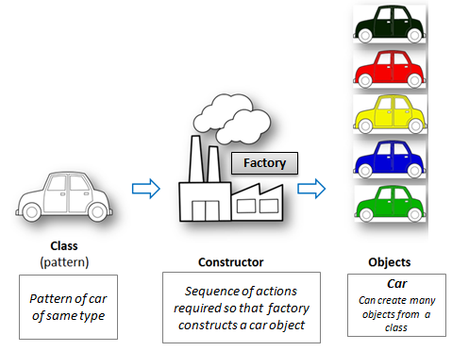
Constructors (OOP)
Constructor is a special method. a function which initializes or activates the attributes or properties of the class for a object. Use keyword __init__ to create a method for constructor. Think of constructor as entire sequence of actions required so that the factory constructs a car object out of the class design pattern. self represents that object which inherits those properties.
Objects are instances of a class. Words 'instance' and 'object' are used interchangeably. The process of creating an object of a class is called instantiation.
class person:
def __init__(self,firstname,lastname):
self.first = firstname
self.last = lastname
myname = person("Deepanshu","Bhalla")
print(myname.last)
We have created myname object of person class.
class MyCompany:
# methods
def __init__(self, compname, revenue, employeesize):
self.name = compname
self.revenue = revenue
self.no_of_employees = employeesize
def productivity(self):
print(self.revenue / self.no_of_employees)
MyCompany('XYZ Bank', 1000,100).productivity()
MyCompany('ABC Bank', 5000,200).productivity()
MyCompany.productivity(Bank)
https://www.listendata.com/2019/08/python-object-oriented-programming.html#basics_oop_in_python

Slide 159
Constructors (OOP)
Constructors
Earlier assigned a default value to a class attribute, can also initialize values using the constructors. Constructors are generally used for instantiating an object. The task of constructors is to initialize(assign values) to the data members of the class when an object of the class is created. It accepts the self-keyword as a first argument which allows accessing the attributes or method of the class.
Types of Constructors
Default Constructor
Parameterized Constructor
Non-Parameterized Constructor
Non-Parameterized Constructor: used when you do not want to manipulate the value or the constructor that has only self as an argument.
Ex:
class Student:
# Constructor - non parameterized
def __init__(self):
print("Non-parametrized constructor:")
def show(self,name):
print("Hello",name)
student = Student()
student.show("Minakshi")
https://www.datacamp.com/tutorial/python-oop-tutorial
Default Constructor: A simple constructor that does not accept any arguments other than self.
Ex:
class Employee:
def __init__(self):
self.data = "Shows Default Data only"
employee1 = Employee()
print(employee1.data)
Parameterized Constructor: can accept additional arguments to initialize the object's attributes with specific values.
Ex:
class Employee:
def __init__(self, name, department):
self.name = name
self.department = department
emp1 = Employee("Alice", "HR")
emp2 = Employee("Bob", "Finance")
print(emp1.name, emp1.department) # Alice HR
print(emp2.name, emp2.department) # Bob Finance

Slide 160
Constructors (OOP)
Ex:
class Employee:
def __init__(self, name, id):
self.id = id
self.name = name
def display(self):
print("ID: %d \nName: %s" % (self.id, self.name))
emp1 = Employee("John", 101)
emp2 = Employee("David", 102)
# accessing display() method to print employee 1 information
emp1.display()
# accessing display() method to print employee 2 information
emp2.display()
https://www.javatpoint.com/python-constructors
https://www.scholarhat.com/tutorial/python/constructors-in-python
Constructors: special type of method (function) which is used to initialize the instance members of the class. the method __init__() simulates the constructor of the class. This method is called when the class is instantiated. It accepts the self-keyword as a first argument which allows accessing the attributes or method of the class.
can pass any number of arguments at the time of creating the class object, depending upon the __init__() definition. It is mostly used to initialize the class attributes. Every class must have a constructor, even if it simply relies on the default constructor.
Counting the number of objects of a class
The constructor is called automatically when we create the object of the class. Consider the following example
Ex:
class Student:
count = 0
def __init__(self):
Student.count = Student.count + 1
s1=Student()
s2=Student()
s3=Student()
print("The number of students:",Student.count)

Slide 161
Constructors :Constructors may become your best friend if you're planning to learn OOP because they are in charge of establishing and initializing new objects in a class.
class Employee:
def __init__(emp, name, age):
emp.name = name
emp.age = age
employee1 =Employee("Disha", 33)
print(employee1.name) , print(employee1.age)
Rules of Constructor
Method Name: __init__ is the required method name for the constructor.
First Argument: instance that is being constructed, or self, must be the first argument passed to the constructor method.
Optional Arguments: constructor can accept different options for initialization by adding additional arguments after self.
Return Value: The constructor initializes the attributes of the object; it does not return any value.
Default Constructor
When we do not include the constructor in the class or forget to declare it, then that becomes the default constructor. It does not perform any task but initializes the objects.
Default Constructor:
Ex: class Student:
roll_num = 101
name = "Joseph"
def display(self):
print(self.roll_num,self.name)
st = Student()
st.display()
Parameterized Constructor
parameterized constructor has multiple parameters along with the self.
Parameterized Constructor:
class Student:
# Constructor - parameterized
def __init__(self, name):
print("This is parametrized constructor")
self.name = name
def show(self):
print("Hello",self.name)
student = Student("John")
student.show()
Non-Parameterized Constructor
non-parameterized constructor uses when we do not want to manipulate the value or the constructor that has only self as an argument.
Non-Parameterized Constructor:
class Student:
# Constructor - non parameterized
def __init__(self):
print("This is non parametrized constructor")
def show(self,name):
print("Hello",name)
student = Student()
student.show("John")

Slide 162
Classes vs Instances
Classes allow you to create user-defined data structures. Classes define functions called methods, which identify the behaviors and actions that an object created from the class can perform with its data.
create a Dog class that stores some information about the characteristics and behaviors that an individual dog can have.
class is a blueprint for how to define something. It doesn’t actually contain any data. The Dog class specifies that a name and an age are necessary for defining a dog, but it doesn’t contain the name or age of any specific dog.
While the class is the blueprint, an instance is an object that’s built from a class and contains real data. An instance of the Dog class is not a blueprint anymore. It’s an actual dog with a name, like Miles, who’s four years old.
Put another way, a class is like a form or questionnaire. An instance is like a form that you’ve filled out with information. Just like many people can fill out the same form with their own unique information, you can create many instances from a single class.
class car:
def __init__(self,modelname, year):
self.modelname = modelname
self.year = year
def display(self):
print(self.modelname,self.year)
c1 = car("Toyota", 2016)
c1.display()
Ex:
class Maths:
def subtract(self,i,j):
print(i-j)
def add(self,i,j):
print(i+j)
m=Maths()
m.subtract(10,6)
m.add(6,8)

Slide 163
Advantages of Using Constructors:
Automatic Initialization: Constructors gives the guarantee that an object is automatically initialized correctly as soon as it is created.
Code Reusability: Can reuse the initialization code across various class instances by declaring a constructor.
Encapsulation: Constructors aid in the organization of the code by helping to encapsulate the initialization logic.
Consistency: minimize errors and inconsistencies by offering a consistent method of initializing objects.

Slide 164
Pillars of OOPS
The Four major Pillars of OOPs are: The four pillars of object-oriented programming (OOPs) are the fundamental principles that help to design and implement object-oriented systems. 1. Abstraction 2. Encapsulation 3. Inheritance 4. Polymorphism
Abstraction: creates simple representations of complex systems by hiding non-essential details. Data abstraction is an essential function of object-oriented programming. Data abstraction refers to providing only necessary information about the data to the user and hiding the background information or implementation. It involves creating abstract classes. A class helps us group data and functions using available access specifiers. We define a standard set of attributes and behaviors for related objects.
Encapsulation: bundling data (attributes) and related behaviors (methods) together in a single unit called an object. In OOPs, Encapsulation is defined as wrapping together the data and functions. Encapsulation also leads to the abstraction of data. To give an example from our daily life, think of a panipuri. All different spices, the stuffing made of potato and peas, sev, boondi, and flavored water, are added together in a puri to make a single panipuri. This is Encapsulation. We have no idea about what spices and ingredients are used. This is data hiding. Encapsulation helps in protection against unauthorized access or modification of the data.
Inheritance: allows objects to inherit the properties and behaviors of existing objects, forming a hierarchical relationship. A class that inherits features from another class is called a subclass or derived class. Objects of subclass acquire properties and features of the parent class. The class that inherits properties of a sub-class is called a Base class or superclass. a real-life example to understand inheritance better. The superclass "Vehicle" represents the common attributes and behaviours shared by all types of vehicles. The attributes such as color, weight, manufacturer, and methods like start(), stop(), and accelerate() are defined in the superclass. The subclass "Car" inherits from the superclass "Vehicle" and adds its own specific attributes and methods. For instance, the Car class introduces attributes like the number of doors and fuel type and methods like openDoor() and closeDoor(), which are unique to cars.
Five different types: 1. Single Inheritance 2. Multilevel Inheritance 3. Hierarchy Inheritance 4. Multiple Inheritance 5. Hybrid Inheritance
Polymorphism: "Poly" means "many", and "morph" means "form", Thus, it refers to something that has many different forms. In technical terms, refers to the ability of objects to take on multiple forms or behaviors. It allows objects of other classes to be treated as objects of a common superclass. a real-life example to understand polymorphism better. The superclass "Animal" defines a generic method called makeSound(). This method does not have a specific implementation in the superclass but should be followed by all the subclasses. Each subclass (Dog, Cat, and Cow) inherits from the Animal superclass and implements the makeSound() method according to the specific sound that the animal makes.

Slide 165

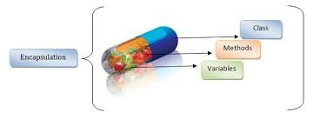
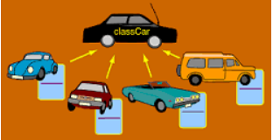
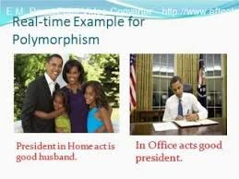
Pillars of OOP
Abstraction Ex: In a keyboard, circuits are connected to the CPU. So, While pressing the key we don't know about the inside happenings of the keyboard. only know that When the keyboard is pressed It will display a similar letter in the screen incase, we are typing. So, this is how Abstraction works. Exposing necessary data
Encapsulation: Next When the key is pressed some kind of message runs through the circuit of the keyboard which is sent to the CPU.CPU analyses that request and accordingly displays the pressed text in the screen. So here we only know that pressing the key will display the letter but In the meanwhile we are totally unaware of the happening inside the circuits. emphasis on hiding the data
Inheritance: There are many keyboards brands available in the market but the similarity between them is that they follow more or less the same prototype as the Keyboard available in the year 2000. So basically they are inheriting the properties of the older generation of keyboards plus they are modifying the newer keyboards with some extra functionalities..
Polymorphism: Polymorphism means Poly[Many] + Morphism[Forms]. It is the ability of the object to behave differently under different situation.. Ex: while writing a word document you will be using the up/down arrows for moving up and down in the document but while playing a car game u will be using the same keys for moving your car in the game. So the same keys are behaving differently on various scenarios and this is called polymorphism.

Slide 166
Pillars of OOP
Encapsulation:
class Cat:
def __init__(self):
self.sound = "meow"
def speak(self):
print("Cat says: {}".format(self.sound))
c = Cat()
c.speak()
# change the price
c.sound = "bow-wow"
c.speak()
In the above example, the class cat has a variable sound that is set to the default value in the constructor, and later we are also changing the value of this variable i.e. c.sound = "bow-wow", Now that you know the meaning of encapsulation as per above definition let's consider class as a capsule, do you think this code follows encapsulation? Well, it doesn't.
Encapsulation
Now, it has been encapsulated. Well, this is the encapsulation.
Some practical examples:
A bank application forbids (restrict) a client to change an Account's balance.
It is also used to hide the data - let's say you log into your email account, there is a lot of process in the backend, that you have no control over. So your password, would probably be retrieved in an encrypted form, verified and only then you are given access. You do not have any control, over how the password is verified, and this keeps it safe from misuse.
To avoid this we can declare the private variables, in Python, we denote private attributes using underscore as the prefix i.e single _ or double __.
class Cat:
def __init__(self):
self.__sound = "meow"
def speak(self):
print("Cat says: {}".format(self.__sound))
c = Cat()
c.speak()
# change the price
c.sound = "bow-wow"
c.speak()
https://dev.to/kedark/pillars-of-oops-in-python-k6a

Slide 167
Pillars of OOP
Inheritance:
Inherit (to receive a quality, characteristic, etc. from your parents or family.)
This allows us to define a class that inherits methods, properties from another class. Let's say you need a new class with little or no modification then you apply this concept.
The base class is called the parent class and the derived class is known as a child.
class Family:
def __init__(self, family_name, number_of_members, country):
self.family_name = family_name
self.number_of_members = number_of_members
self.country=country
def member_says(self):
print(f"Hey, I am from {self.family_name} family and there are {self.number_of_members} members in family")
class Family_detailed:
def __init__(self, family_name, number_of_members, country):
self.family_name = family_name
self.number_of_members = number_of_members
self.country=country
def member_says(self):
print(f"Hey, I am from {self.family_name} family and there are {self.number_of_members} members in family")
def which_country(self):
print(f"The {self.family_name} family has roots from {self.country}" )
a = Family("Rodrigues",5,"Peru")
b = Family_detailed("Bezos",15,"United States of America")
a.member_says()
b.member_says()
b.which_country()
Inheritance

Slide 168
Pillars of OOP
Inheritance:
The purpose of the first class is to display family names and the number of members but the second class wants to display the same information along with the country.
As you see there is a lot of common code here, let's use inheritance to make it simpler.
Inheritance
class Family:
def __init__(self, family_name, number_of_members, country):
self.family_name = family_name
self.number_of_members = number_of_members
self.country=country
def member_says(self):
print(f"Hey, I am from {self.family_name} family and there are {self.number_of_members} members in family")
class Family_detailed(Family):
def which_country(self):
print(f"The {self.family_name} family has roots from {self.country}" )
a = Family("Rodrigues",5,"Peru")
b = Family_detailed("Bezos",15,"United States of America")
a.member_says()
b.member_says()
b.which_country()
Note: code has reduced significantly. So, this was the inheritance, let's move to the next pillar.

Slide 169
Pillars of OOP
Abstraction:
Abstraction (A general idea rather than one relating to a particular object, person, or situation.)
let's take an ex of a car, people don't see the car as thousands of individual parts, instead, they see it as a well-defined object with unique behavior. They don't need to understand the complexity of those parts and how to collaborate with each other. The same goes with a vending machine, you just want to put money in and get your favorite snack and there is no need of understanding how the system works.
in simple terms, Abstraction focuses on hiding the internal implementations of a process or method from the user. In this way, the user knows what they are doing but not how the work is being done.
This is a little different than the other pillars. Python does not grant abstract classes by default. Instead, Python comes with a module that fits the base for Abstract Base classes(ABC) and that module name is ABC. A method becomes abstract when decorated with the keyword @abstractmethod
Abstraction
from abc import ABC, abstractmethod
class Company(ABC):
def work(self):
pass
class Manager(Company):
def work(self):
print("I assign work to and manage team")
class Employee(Company):
def work(self):
print("I complete the work assigned to me")
# Driver code
R = Manager()
R.work()
K = Employee()
K.work()

Slide 170

Pillars of OOP
Polymorphism:
polymorphism (the condition of occurring in several different forms)
One of the awesome examples of understanding this will be Ben 10. He's one person but he can serve the world in multiple forms.
Back to programming, it refers to the use of a single method/operator to represent different types in different scenarios.
Python can use multiple classes in the same way, using Polymorphism. To serve this purpose, we can create a loop that iterates through a tuple of objects. And this will allow us to call methods without looking at the class to which the object is pointing.
Polymorphism
class Class1():
def pt(self):
print("This function determines class 1")
class Class2():
def pt(self):
print("This function determines class 2.")
obj1 = Class1()
obj2 = Class2()
for type in (obj1, obj2): # creating a loop to iterate through the obj1, obj2
type.pt()
similarly talking about the operators, let's look at the + operator.
print(1+2), print ("a"+"b")
As you see, the + operator behaves different way with different datatypes.

Slide 171
GUI
Introduction to GUI in PythonGUI (Graphical User Interface): A way for users to interact with applications using windows, buttons, text fields, menus, etc., instead of typing commands in the terminal.
Python provides several libraries for GUI development:
Tkinter (standard, built-in)
PyQt / PySide (advanced, supports modern apps)
Kivy (for mobile & multi-touch apps)
wxPython (native look & feel apps)
GUI makes applications user-friendly and suitable for real-world use.
What is Tkinter and How to Use It:
Tkinter: Standard Python library for GUI programming. Comes pre-installed with Python. Lightweight and easy to learn.
import tkinter as tk
root = tk.Tk() # Create main application window
root.title("My GUI App")
root.geometry("300x200") # Set window size (width x height)
root.mainloop() # Run the application loop
Tk() → main window.
mainloop() → keeps the window running until the user closes it.
main application window
Tk() creates the main window (a blank GUI window).
We call it root because it’s the "root" window for the app.
This is where all other widgets (buttons, labels, etc.) will live.
root.mainloop():
This keeps the window open and listens for user actions (like clicks, key presses, etc.).
Without mainloop(), the window would appear and then instantly close.
It’s like the "engine" that keeps the GUI running.

Slide 172
Adding a Button: Used to trigger actions/events when clicked.
import tkinter as tk
def on_click():
print("Button clicked!")
root = tk.Tk()
button = tk.Button(root, text="Click Me", command=on_click)
button.pack()
root.mainloop()
Parameters:
text → label of button
command → function to execute when clicked.
pack(), .grid(), .place() → methods to arrange widgets
Creating Entry Widget: Entry widget allows users to input single-line text.
import tkinter as tk
root = tk.Tk()
entry = tk.Entry(root, width=30)
entry.pack()
def show_text():
print("Entered:", entry.get())
btn = tk.Button(root, text="Submit", command=show_text)
btn.pack()
root.mainloop()
entry.get() → retrieves text entered
entry.insert(pos, text) → insert textentry.
delete(start, end) → delete text

Slide 173
Creating Text Widget: Text widget is for multi-line input/output (like a notepad).
import tkinter as tk
root = tk.Tk()
text = tk.Text(root, height=5, width=30)
text.pack()
def get_text():
print(text.get("1.0", "end-1c")) # from line 1, char 0 to end
btn = tk.Button(root, text="Show Text", command=get_text)
btn.pack()
root.mainloop()
Creating Check Button: Allows multiple selections (like yes/no, hobbies).
import tkinter as tk
root = tk.Tk()
var1 = tk.IntVar()
var2 = tk.IntVar()
chk1 = tk.Checkbutton(root, text="Python", variable=var1)
chk2 = tk.Checkbutton(root, text="Java", variable=var2)
chk1.pack()
chk2.pack()
def show_selection():
print("Python:", var1.get(), "Java:", var2.get())
btn = tk.Button(root, text="Submit", command=show_selection)
btn.pack()
root.mainloop()

Slide 174
Creating Radio Button: Allows single selection from multiple options.
import tkinter as tk
root = tk.Tk()
var = tk.StringVar()
rb1 = tk.Radiobutton(root, text="Male", variable=var, value="Male")
rb2 = tk.Radiobutton(root, text="Female", variable=var, value="Female")
rb1.pack()
rb2.pack()
def show_choice():
print("Selected:", var.get())
btn = tk.Button(root, text="Submit", command=show_choice)
btn.pack()
root.mainloop()
Creating List Boxes: Displays a list of items, allows selection.
import tkinter as tk
root = tk.Tk()
listbox = tk.Listbox(root)
listbox.insert(1, "Python")
listbox.insert(2, "Java")
listbox.insert(3, "C++")
listbox.pack()
def show_selection():
print("Selected:", listbox.get(listbox.curselection()))
btn = tk.Button(root, text="Show", command=show_selection)
btn.pack()
root.mainloop()

Slide 175
Develop Menus Option: Menus are used for navigation (like File, Edit, Help).
import tkinter as tk
root = tk.Tk()
menu_bar = tk.Menu(root)
file_menu = tk.Menu(menu_bar, tearoff=0)
file_menu.add_command(label="New")
file_menu.add_command(label="Open")
file_menu.add_separator()
file_menu.add_command(label="Exit", command=root.quit)
menu_bar.add_cascade(label="File", menu=file_menu)
root.config(menu=menu_bar)
root.mainloop()

Slide 176
dir() Function: dir() lists the directory of attributes
The dir() function in Python is a built-in function. used to List all the attributes (variables, functions, classes, etc.) of an object. Inspect what properties, methods, and names are available in a module, class, instance, or object. It is mainly used for introspection (checking the structure of an object at runtime).
import math
print(dir(math)) # Lists all constants and functions in math module
What does dir() show?
Built-in attributes/methods (starting and ending with __ dunder methods).
User-defined attributes/methods if applied to a class, instance, or module.
Example with Modules:
import os
print(dir(os))
Lists all functions and attributes available in the os module.
x = [1, 2, 3]
print(dir(x))
Output will include methods like:append, clear, copy, extend, index, insert, pop, remove, reverse, sort.
The dir() function is a powerful tool in Python for introspection and exploration. It lists all the attributes (variables, methods, classes, etc.) available in the current scope, or for a given object/module. This makes it especially useful for debugging, learning new libraries, and understanding objects.

Slide 177
PyPI (Python Package Index)
It is the official online repository where Python developers publish and share open-source Python packages and libraries. an app store for Python code.
Key Points about PyPI:
Full form: Python Package Index.
Website: https://pypi.org.
Purpose: Provides a central place to download, install, and share Python packages.
Contents: Thousands of community-contributed packages (e.g., Django, Flask, NumPy, Pandas).
Who manages it: Maintained by the Python Packaging Authority (PyPA).
Developers upload packages.
Users install packages.

Slide 178
Regular Expressions (Regex)
Definition: Regular Expressions (regex) are patterns used to search, match, and manipulate text. In Python, regex is implemented through the built-in re module.
Where to Use:
Validation: Check if input matches a pattern (e.g., email, phone number, password).
Searching: Find words or patterns in a large block of text.
Extraction: Extract useful information (e.g., dates, prices, hashtags).
Data Cleaning: Remove unwanted characters, symbols, or whitespace.
String Manipulation: Replace or split text based on patterns.
Simple, Special Characters Matching Examples
import re
text = "Python is powerful"
pattern = r"Python"
match = re.search(pattern, text)
print(match)
text = "Python is powerful“
pattern = r"Python“: looks for the exact word Python.
re.search(pattern, text): finds the first occurrence of "Python" in the string.
Since "Python" is present at the very beginning, match will be a match object, not the text itself.
Printing match shows its details:
<re.Match object; span=(0, 6), match='Python’>: This tells you it’s a match object, i.e., the result of the regex search.
span=(0, 6)This shows the start and end index positions of the match in the string.
0: the match starts at index 0 (the very first character of the string).
6: the match ends at index 6 (exclusive, meaning up to index 5).

Slide 179
Regular Expressions (Regex)
It is the official online repository where Python developers publish and share open-source Python packages and libraries.
number_match=re.findall(r"\d", "My number is 9876") # ['9', '8', '7', '6']
string_match=re.findall(r"\w", "Hi_123!") # ['H', 'i', '_', '1', '2', '3']
pattern_match=re.findall(r"\s", "Hello World") # [' ']
print(number_match)
print(string_match)
print(pattern_match)
Match if string starts with "Hello“
import re
text = "Hello World"
if re.match("^Hello", text):
print("Match found")
Real-Time Environments:
Email addresses: username@domain.com
Mobile numbers: 10-digit numbers
Passwords: Strong passwords with rules (uppercase, lowercase, digits, special chars)
Special Characters
. (dot) → Matches any single character except newline.
\d → Matches digits (0–9).
\D → Matches non-digit characters.
\w → Matches word characters (a–z, A–Z, 0–9, _).
\W → Matches non-word characters.
\s → Matches whitespace (space, tab, newline).
\S → Matches non-whitespace characters.

Slide 180
Regular Expressions (Regex)
Email Validation
import re
email = "user@example.com"
if re.match(r"^[a-zA-Z0-9._]+@[a-z]+\.[a-z]{2,3}$", email):
print("Valid Email")
else:
print("Invalid Email")
Data Extraction / Parsing
Examples: Extract all phone numbers from a document.
Extract hashtags from social media posts.
Extract dates, times, or IP addresses from logs.
Why it’s useful: Automates data cleaning & extraction from unstructured text.
text = "Call me at 9876543210 or 9123456789"
numbers = re.findall(r"\d{10}", text)
print(numbers) # ['9876543210', '9123456789']
Log Analysis & Monitoring
In real-time systems like servers, banking apps, or e-commerce, logs are generated constantly.
Regex helps in: Detecting errors in logs. Extracting IP addresses, user actions, timestamps.
log = "Error: User 192.168.0.1 failed login"
ip = re.findall(r"\d+\.\d+\.\d+\.\d+", log)
print(ip) # ['192.168.0.1']
Text Processing & Web Scraping
Regex is often used to scrape data from websites or documents.
Examples: Extract all links (<a href="...">) from HTML pages. Extract prices from e-commerce websites.
Why it’s useful: Automates large-scale data collection.
Automation in Real-Time Applications
Regex is lightweight and fast, perfect for scripts or automated pipelines.
Examples:
Auto-formatting CSV files.
Validating API input in web applications.
Detecting spam or phishing emails.

Slide 181
Decorator
A decorator in Python is a special function that adds extra functionality to another function or method without changing its actual code. It’s often used for things like logging, authentication, performance measuring, etc.
How it works: A decorator is just a function that takes another function as input and returns a new function with added behavior. apply it using the @decorator_name syntax above a function.
def add_sprinkles(func):
def wrapper():
func()
print("you add sprinkles")
return wrapper
@add_sprinkles
def get_icecream():
print("Here is your ice cream")
get_icecream()
Defining the decorator
add_sprinkles is a decorator function.
It takes another function func as an argument.
In this case, func will eventually be get_icecream.
Defining the inner wrapper function
wrapper is a nested function inside add_sprinkles.
This is the function that will actually replace get_icecream when we decorate it.
Decorators usually use a wrapper so you can add extra behavior before or after calling the original function.
Adding behavior inside the wrapper
This is extra behavior added by the decorator.
It runs before calling the original function.
In our case, it’s like “adding sprinkles to ice cream.”
Calling the original function
Here we call the original function (get_icecream) inside the wrapper.
This ensures the main behavior of get_icecream still happens.
So after printing “you add sprinkles,” it prints “Here is your ice cream.”

Slide 182
Decorator
def my_decorator(func):
def wrapper():
print("Before the function runs")
func()
print("After the function runs")
return wrapper
@my_decorator
def say_hello():
print("Hello!")
say_hello()
Here, @my_decorator automatically wraps say_hello with extra code.
Decorators help in code reusability and cleaner syntax.
They are widely used in Flask, Django, and logging.
Can also take arguments (called parameterized decorators).
Decorators with Arguments
def decorator_with_args(func):
def wrapper(name):
print(f"Hello, {name}! Before function runs")
func(name)
print(f"Goodbye, {name}! After function runs")
return wrapper
@decorator_with_args
def greet(name):
print(f"Greetings, {name}!")
greet("Sachin")
Summary
Basic decorator: Adds behavior before/after a function.
With arguments: Supports functions with parameters.
With return values: Can modify or return results.
Parameterized decorator: Decorator itself takes arguments.
Preserving metadata: Use functools.wraps.
Multiple decorators: Can stack for complex behavior.
Practical use cases: Logging, timing, access control, caching, retries.

Slide 183
Generator
Generator is a special type of function that produces values one at a time using yield instead of returning them all at once with return.
Normal function (return): Runs once, returns a value, then stops.
Generator function (yield): Can pause and resume, producing values on demand.
Generator Example
def my_generator():
yield 1
yield 2
yield 3
gen = my_generator()
print(next(gen))
print(next(gen))
print(next(gen))
yield keyword
Generator is a special type of function that produces values
yield is like a pause button for a function. Returns the value to the caller (like return). But instead of ending the function completely, it pauses the function and remembers its state (local variables, where it left off, etc.).When you call next() again, the function resumes right after the yield statement.
next() function
next() is how you resume the generator from where it left off.
Each time you call next(gen), Python continues execution until it hits the next yield. If there are no more yields, Python raises a StopIteration error (that’s how Python knows the generator is finished).
Yield: pauses the function and gives back a value.
next(): resumes the generator from where it left off.
Iterating Over Generators
def my_generator():
yield "A"
yield "B"
yield "C"
for val in my_generator():
print(val)

Slide 184
Generator
Difference Between return and yield
def normal_func():
return [1, 2, 3]
def generator_func():
yield 1
yield 2
yield 3
print(normal_func())
print(list(generator_func()))
Generator with Loop
def count_up_to(n):
for i in range(1, n+1):
yield i
for num in count_up_to(5):
print(num)
lists and generators in terms of memory usage
import sys
# Create list directly
numbers_list = [i for i in range(1000000)]
# Memory used
print("Memory used by list:", sys.getsizeof(numbers_list), "bytes")
# Iterate over list
for num in numbers_list:
pass
# Generator function using yield
def numbers_gen():
for i in range(1000000):
yield i
# Create generator object
gen = numbers_gen()
# Memory used
print("Memory used by generator with yield:", sys.getsizeof(gen), "bytes")
# Iterate over generator
for num in gen:
pass

Slide 185
Memory Efficiency
Generators produce items one at a time, instead of storing the whole sequence in memory.
Huge datasets can be processed without running out of RAM.
Example: iterating over millions of numbers, reading large files, or streaming data.
Pipelining / Streaming
Generators can be chained to process data in stages, like a pipeline.
Example: Read a file line by line → filter → transform → sum, all without storing the whole file in memory.
Infinite Sequences
Generators can represent sequences with no end, something impossible with lists.
Cleaner Code for Iteration
Using generators often leads to simpler, more readable code for loops, pipelines, or processing large datasets.
Memory savings are just the tip of the iceberg. Generators are also about lazy evaluation, efficiency, streaming data, infinite sequences, and clean code.

Slide 186
List vs Generator
Feature | List | Generator
Definition | Collection that stores all elements in memory | Special function using yield that produces values one at a time
Memory Usage | Stores all elements → High memory usage | Very memory-efficient (produces values lazily)
Creation | [1, 2, 3] | def func(): yield ...
Reusability | Reusable (can loop multiple times) | One-time use (gets exhausted)
Speed | Fast for small data (direct access by index) | Slower (computes values on demand)
Use Cases | Small datasets, need random access, multiple iterations | Large datasets, streaming data, infinite sequences
Example | nums = [x*x for x in range(5)] | def squares(): yield x*x

Slide 187
Ex: https://www.listendata.com/2019/08/python-object-oriented-programming.html
Ex: https://www.datacamp.com/tutorial/python-oop-tutorial
Ex: https://python.plainenglish.io/everything-about-methods-classes-in-python-6bffa1adb5d8
Ex: https://third-bit.com/sdxpy/oop/

Slide 188
Syllabus covered
Computer basics
Variable Names and Values
Data types (Str, Int, Float, Complex)
Input function
String methods
Operators
Modules (Range, Randrange, max, min)
Data structures (List, Tuples, Sets & Dictionaries)
For loops
If and else
While
Functions
Lambda (Filter, Map, Reduce)
Error Handling
File Handling
Modules
OOPs
Yet to Cover:
Tkinter (GUI)
Go through topics
File handling with csv files
Python Date and Time
Python Math & Statistics Module
Python Json

Slide 189

